Slide 1
Input/Output Organization
Chapter 19

Slide 2
Outline
Introduction
Accessing I/O devices
An example I/O device
  Keyboard
I/O data transfer
  Programmed I/O
  DMA
Error detection and correction
  Parity encoding
  Error correction
  CRC
External interface
  Serial transmission
  Parallel interface
USB
  Motivation
  USB architecture
  USB transactions
IEEE 1394
  Advantages
  Transactions
  Bus arbitration
  Configuration
Chapter 19: Page <number>

Slide 3
Introduction
I/O devices serve two main purposes
  To communicate with outside world
  To store data
I/O controller acts as an interface between the systems bus and I/O device
  Relieves the processor of low-level details
  Takes care of electrical interface
I/O controllers have three types of registers
  Data
  Command
  Status
Chapter 19: Page <number>

Slide 4
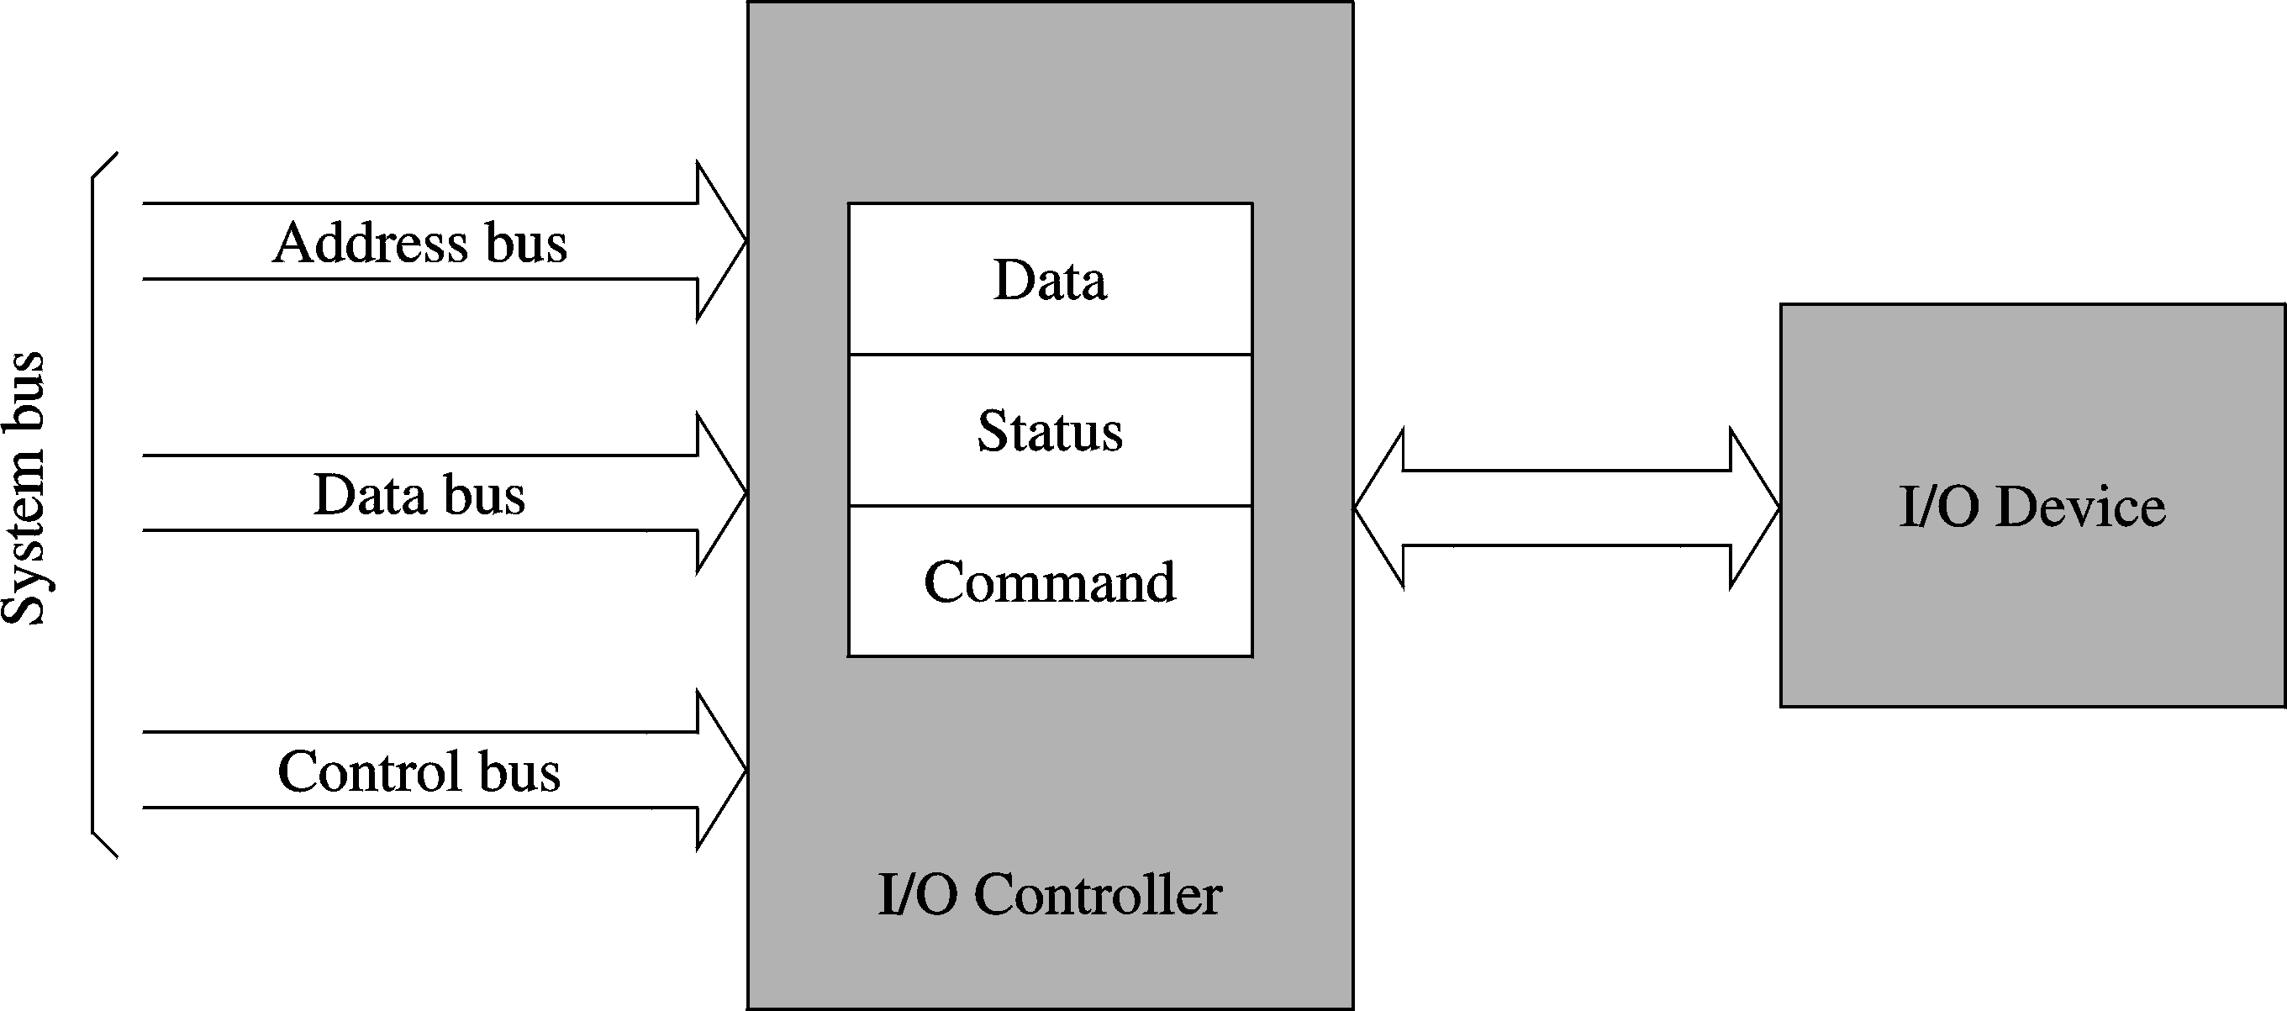
Introduction (cont’d)
Chapter 19: Page <number>

Slide 5
Introduction (cont’d)
To communicate with an I/O device, we need
  Access to various registers (data, status,…)
    This access depends on I/O mapping
      Two basic ways
        Memory-mapped I/O
        Isolated I/O
  A protocol to communicate (to send data, …)
    Three types
      Programmed I/O
      Direct memory access (DMA)
      Interrupt-driven I/O
Chapter 19: Page <number>

Slide 6
Accessing I/O Devices
I/O address mapping
  Memory-mapped I/O
    Reading and writing are similar to memory read/write
    Uses same memory read and write signals
    Most processors use this I/O mapping
  Isolated I/O
    Separate I/O address space
    Separate I/O read and write signals are needed
    Pentium supports isolated I/O
      64 KB address space
        Can be any combination of 8-, 16- and 32-bit I/O ports
      Also supports memory-mapped I/O
Chapter 19: Page <number>

Slide 7
Accessing I/O Devices (cont’d)
Accessing I/O ports in Pentium
  Register I/O instructions
    in accumulator, port8 ; direct format
      Useful to access first 256 ports
    in accumulator,DX ; indirect format
      DX gives the port address
  Block I/O instructions
    ins and outs
      Both take no operands---as in string instructions
    ins: port address in DX, memory address in ES:(E)DI
    outs: port address in DX, memory address in ES:(E)SI
    We can use rep prefix for block transfer of data
Chapter 19: Page <number>

Slide 8
An Example I/O Device
Keyboard
  Keyboard controller scans and reports
      Key depressions and releases
    Supplies key identity as a scan code
      Scan code is like a sequence number of the key
        Key’s scan code depends on its position on the keyboard
        No relation to the ASCII value of the key
  Interfaced through an 8-bit parallel I/O port
    Originally supported by 8255 programmable peripheral interface chip (PPI)
Chapter 19: Page <number>

Slide 9
An Example I/O Device (cont’d)
8255 PPI has three 8-bit registers
    Port A (PA)
    Port B (PB)
    Port C (PC)
  These ports are mapped as follows
      8255 register Port address
      PA (input port) 60H
      PB (output port) 61H
      PC (input port) 62H
      Command register 63H
Chapter 19: Page <number>

Slide 10
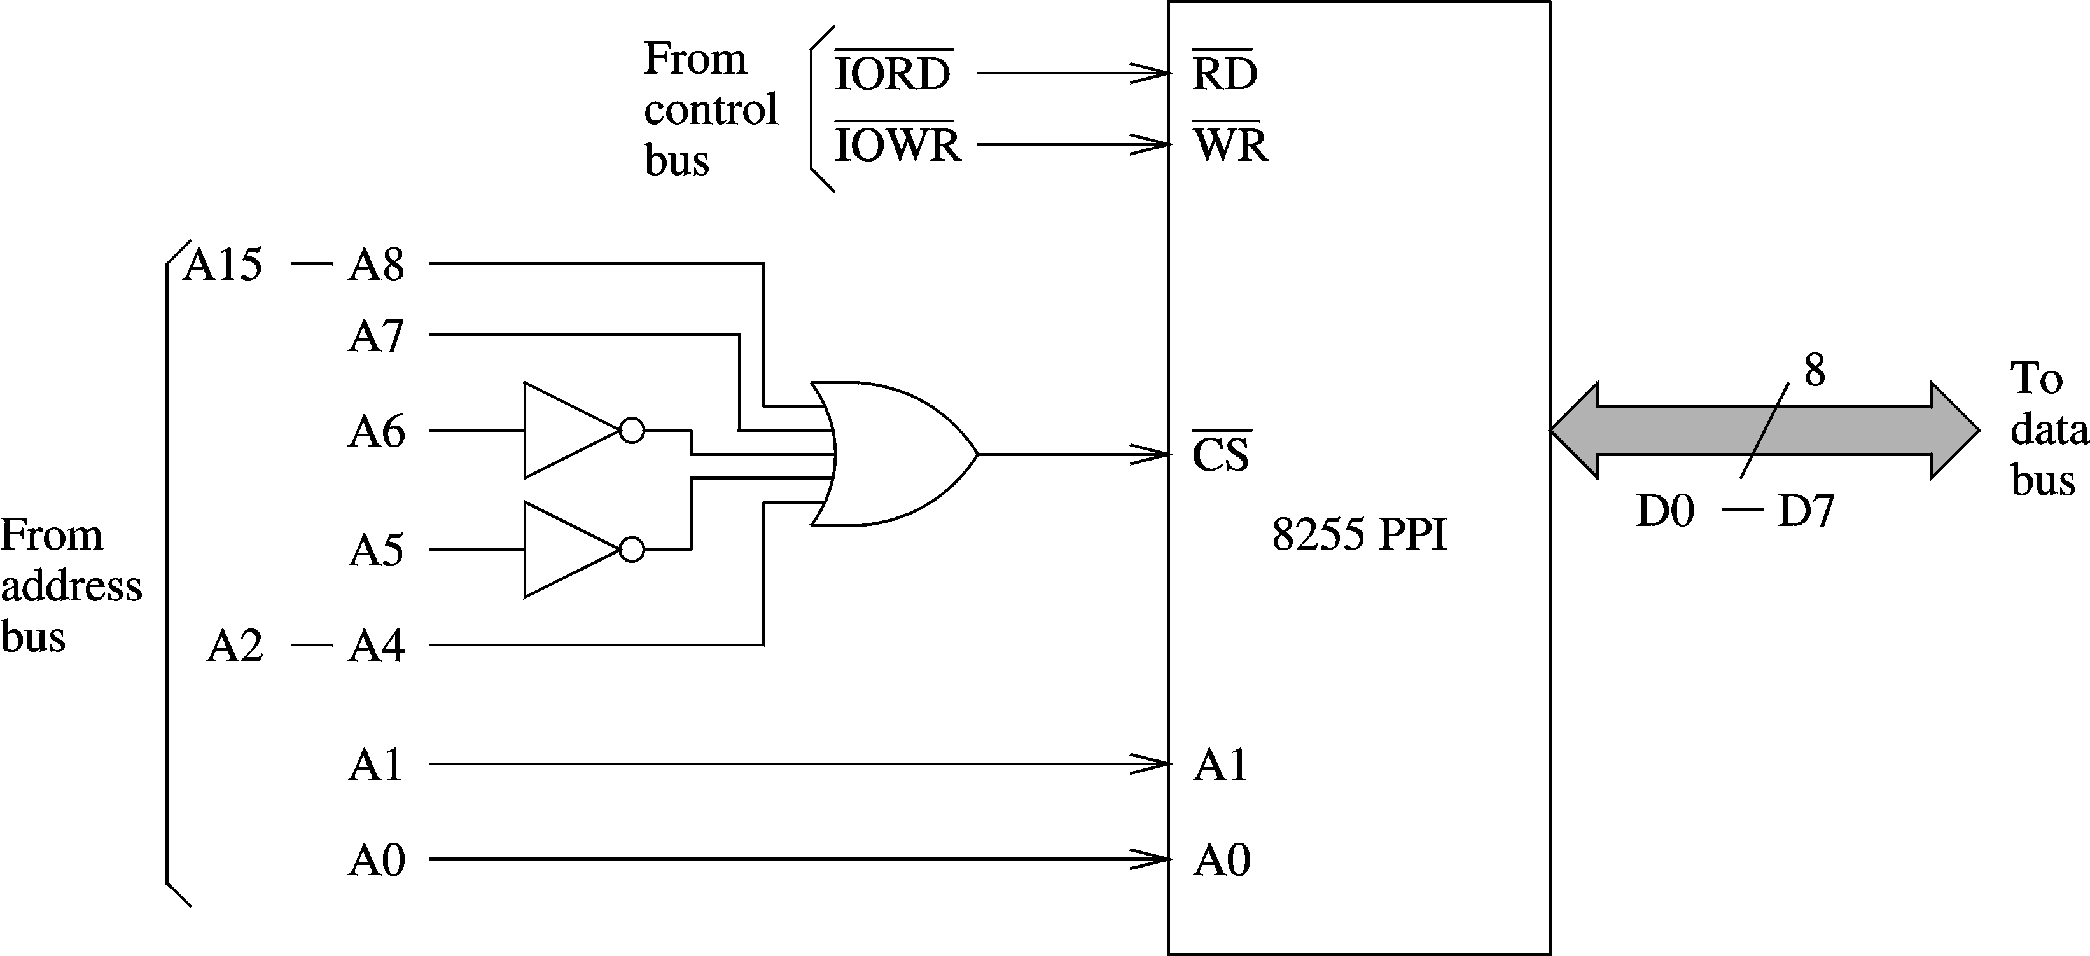
An Example I/O Device (cont’d)
Mapping of 8255 I/O ports
Chapter 19: Page <number>

Slide 11
An Example I/O Device (cont’d)
Mapping I/O ports is similar to mapping memory
  Partial mapping
  Full mapping
    See our discussion in Chapter 16
Keyboard scan code and status can be read from port 60H
  7-bit scan code is available from
    PA0 – PA6
  Key status is available from PA7
    PA7 = 0 – key depressed
    PA0 = 1 – key released
Chapter 19: Page <number>

Slide 12
I/O Data Transfer
Data transfer involves two phases
  A data transfer phase
    It can be done either by
      Programmed I/O
      DMA
  An end-notification phase
    Programmed I/O
    Interrupt
Three basic techniques
  Programmed I/O
  DMA
  Interrupt-driven I/O (discussed in Chapter 20)
Chapter 19: Page <number>

Slide 13
I/O Data Transfer (cont’d)
Programmed I/O
  Done by busy-waiting
    This process is called polling
Example
  Reading a key from the keyboard involves
    Waiting for PA7 bit to go low
      Indicates that a key is pressed
    Reading the key scan code
    Translating it to the ASCII value
    Waiting until the key is released
  Program 19.1 uses this process to read input from the keyboard
Chapter 19: Page <number>

Slide 14
I/O Data Transfer (cont’d)
Direct memory access (DMA)
  Problems with programmed I/O
    Processor wastes time polling
      In our example
        Waiting for a key to be pressed,
        Waiting for it to be released
    May not satisfy timing constraints associated with some devices
      Disk read or write
  DMA
    Frees the processor of the data transfer responsibility
Chapter 19: Page <number>

Slide 15
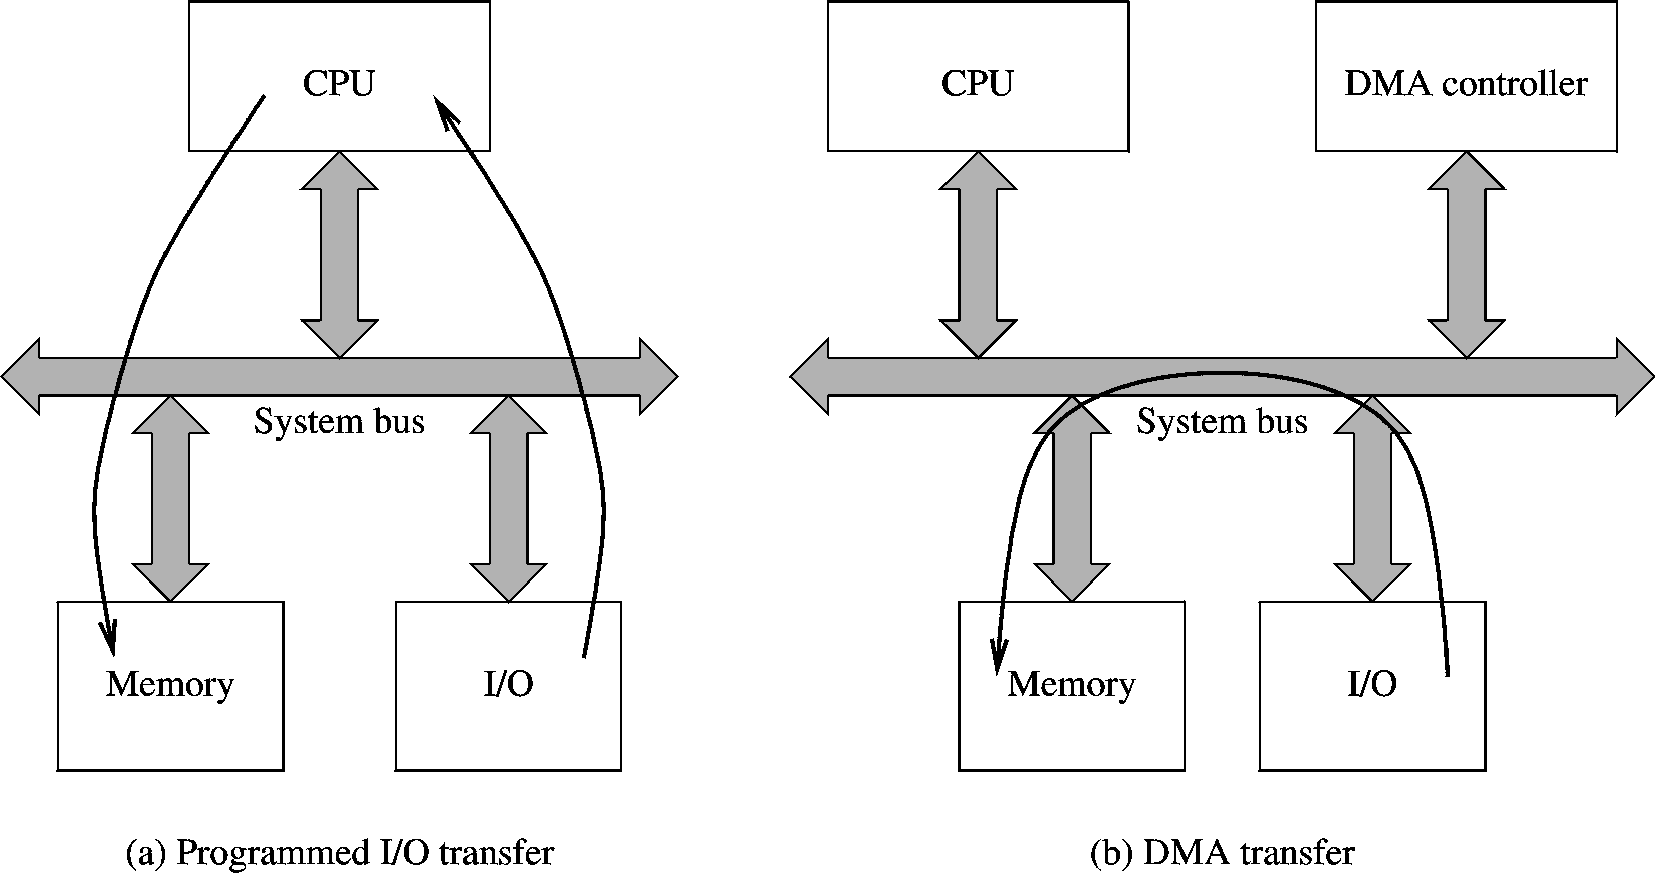
I/O Data Transfer (cont’d)
Chapter 19: Page <number>

Slide 16
I/O Data Transfer (cont’d)
DMA is implemented using a DMA controller
  DMA controller
    Acts as slave to processor
    Receives instructions from processor
    Example: Reading from an I/O device
      Processor gives details to the DMA controller
        I/O device number
        Main memory buffer address
        Number of bytes to transfer
        Direction of transfer (memory → I/O device, or vice versa)
Chapter 19: Page <number>

Slide 17
I/O Data Transfer (cont’d)
Steps in a DMA operation
  Processor initiates the DMA controller
    Gives device number, memory buffer pointer, …
      Called channel initialization
    Once initialized, it is ready for data transfer
  When ready, I/O device informs the DMA controller
    DMA controller starts the data transfer process
      Obtains bus by going through bus arbitration
      Places memory address and appropriate control signals
      Completes transfer and releases the bus
      Updates memory address and count value
      If more to read, loops back to repeat the process
  Notify the processor when done
    Typically uses an interrupt
Chapter 19: Page <number>

Slide 18
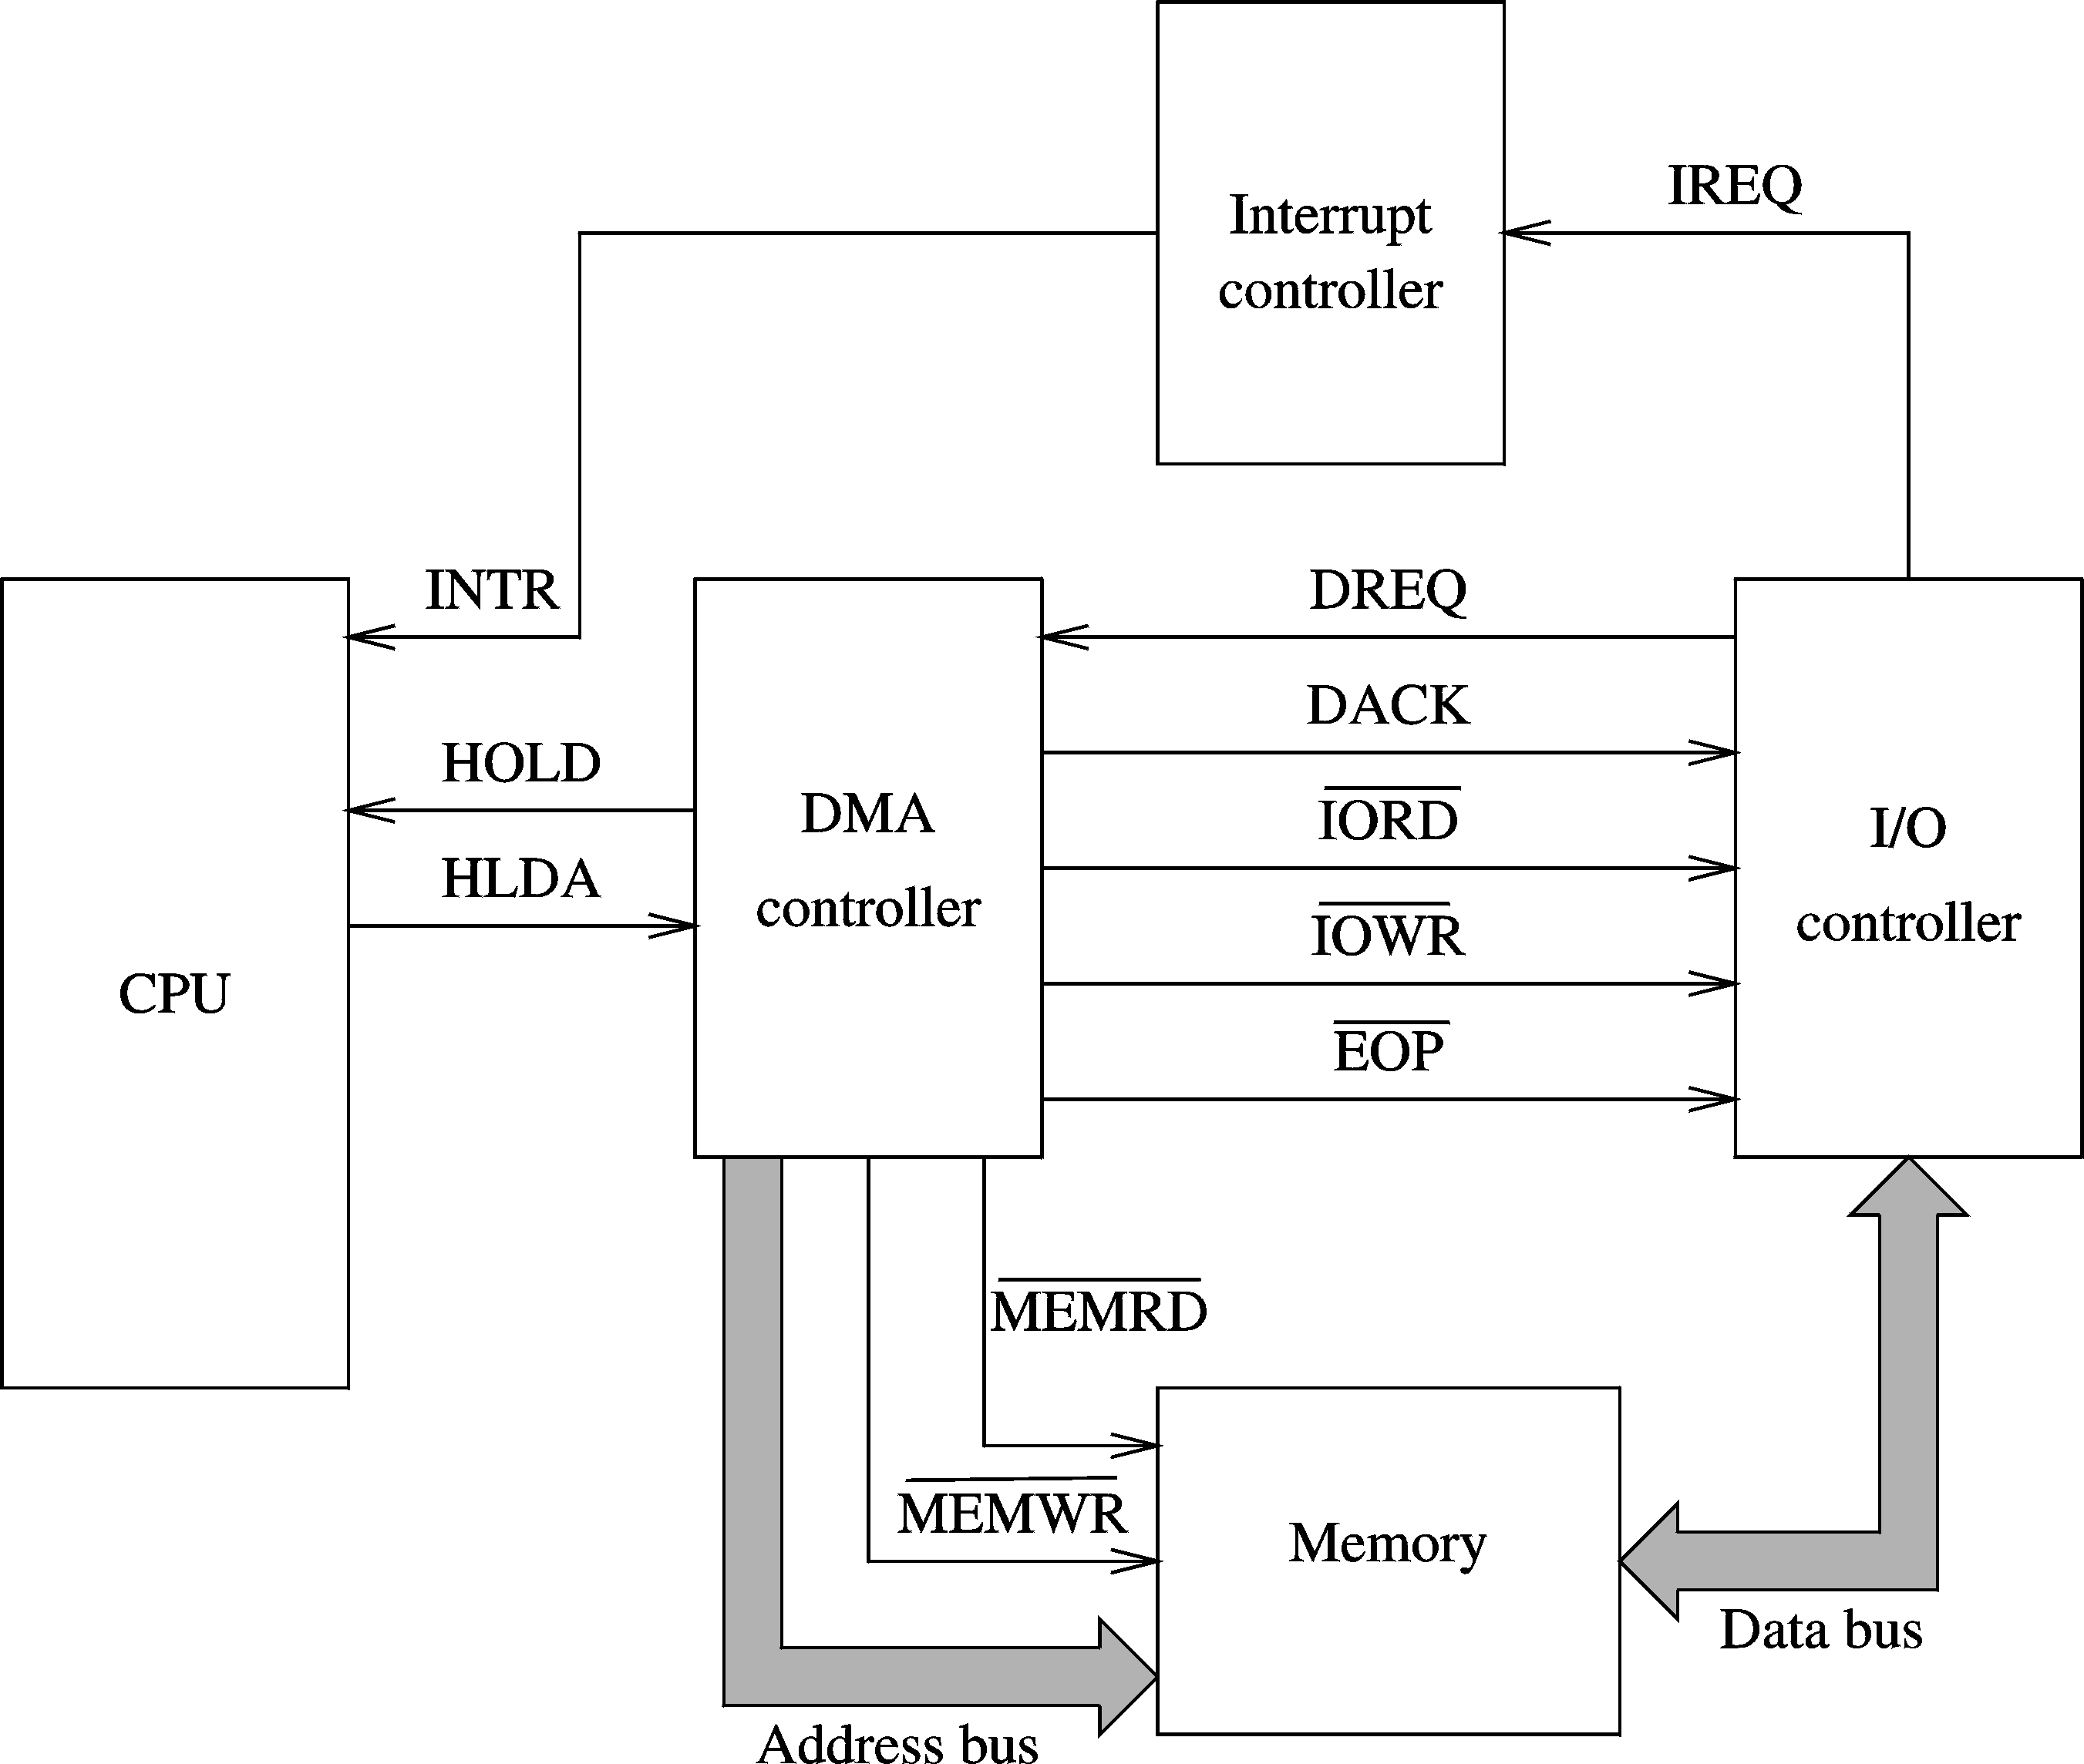
I/O Data Transfer (cont’d)
DMA controller details
Chapter 19: Page <number>

Slide 19
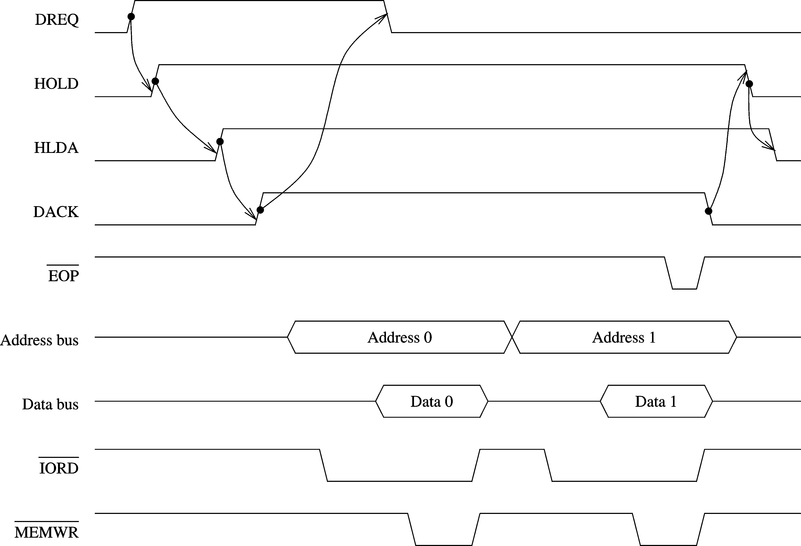
I/O Data Transfer (cont’d)
DMA transfer timing
Chapter 19: Page <number>

Slide 20
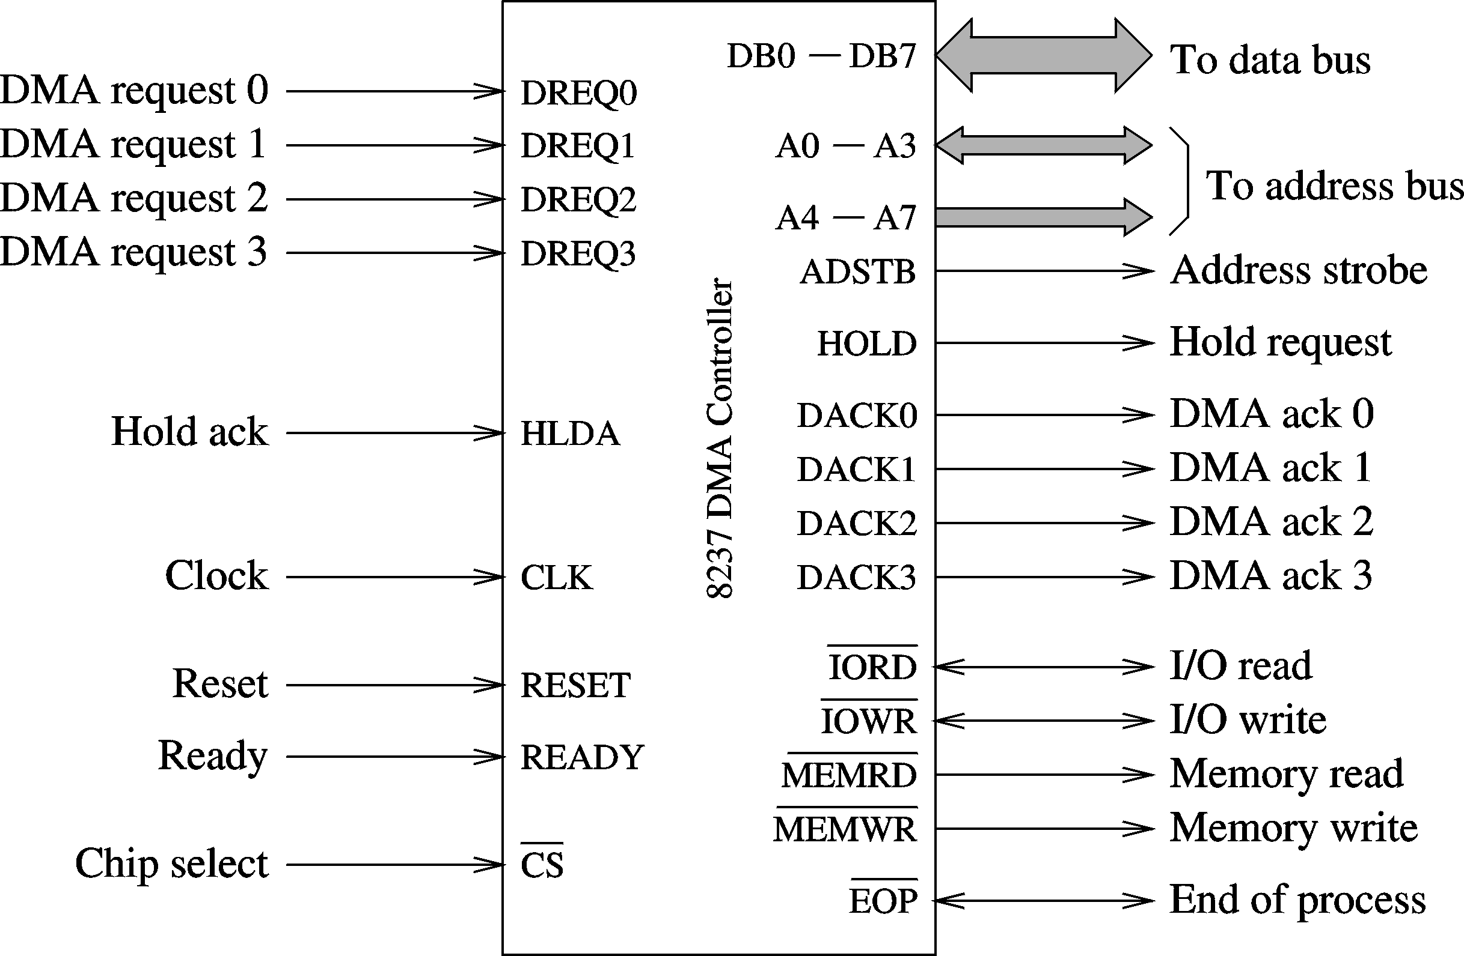
I/O Data Transfer (cont’d)
8237 DMA controller
Chapter 19: Page <number>

Slide 21
I/O Data Transfer (cont’d)
8237 supports four DMA channels
It has the following internal registers
  Current address register
    One 16-bit register for each channel
    Holds address for the current DMA transfer
  Current word register
    Keeps the byte count
    Generates terminal count (TC) signal when the count goes from zero to FFFFH
  Command register
    Used to program 8257 (type of priority, …)
Chapter 19: Page <number>

Slide 22
I/O Data Transfer (cont’d)
  Mode register
    Each channel can be programmed to
      Read or write
      Autoincrement or autodecrement the address
      Autoinitialize the channel
  Request register
    For software-initiated DMA
  Mask register
    Used to disable a specific channel
  Status register
  Temporary register
    Used for memory-to-memory transfers
Chapter 19: Page <number>

Slide 23
I/O Data Transfer (cont’d)
8237 supports four types of data transfer
  Single cycle transfer
    Only single transfer takes place
    Useful for slow devices
  Block transfer mode
    Transfers data until TC is generated or external EOP signal is received
  Demand transfer mode
    Similar to the block transfer mode
    In addition to TC and EOP, transfer can be terminated by deactivating DREQ signal
  Cascade mode
    Useful to expand the number channels beyond four
Chapter 19: Page <number>

Slide 24
Error Detection and Correction
Parity encoding
    Simplest mechanism
    Adds rudimentary error detection capability
  Add a parity bit such that the total number of 1s is
    odd (odd-parity)
    even (even-parity)
  Advantage:
    Simple to implement
  Disadvantage
    Can be used to detect single-bit errors
      Cannot detect even number of bit errors
Chapter 19: Page <number>

Slide 25
Error Detection and Correction (cont’d)
Error correction
  Need to know the error bit position
    To correct, simply flip the bit
  To correct single-bit errors in d data bits
    Add p parity bits
    Codeword C = d + p bits
  How many parity bits do we need?
    Depends on d
    Hamming distance between codewords
      Number of bit positions in which the two codewords differ
    Hamming distance of code
      Smallest Hamming distance between any pair of codewords in the code
Chapter 19: Page <number>

Slide 26
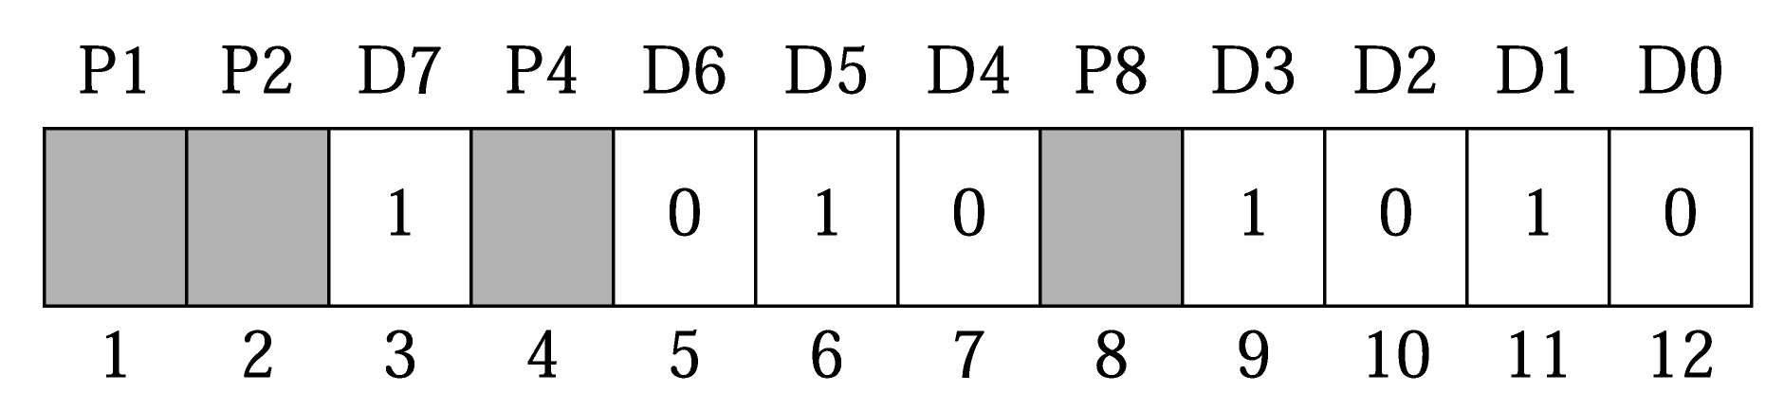
Error Detection and Correction (cont’d)
Constructing codewords to correct single bit errors
  Count bit positions from left to right starting from 1
  Parity bits are in positions that are a power of 2
    Parity bits are called check bits
    Example for 8-bit data (d = 8)
      We need 4 check bits
      Codeword is 12 bits long

Slide 27
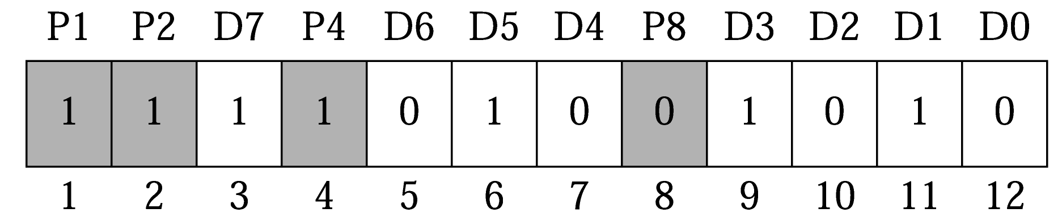
Error Detection and Correction (cont’d)
Check bits are derived as in the parity scheme
    Uses even parity
  Each check bit is responsible for checking certain bits
    P1: checks bits 1, 3, 5, 7, 9, and 11
    P2: checks bits 2, 3, 6,7, 10, and 11
    P4: checks bits 4,5,6,7, and 12
    P8: checks bits 8,9,10,11, and 12
  Example
Chapter 19: Page <number>

Slide 28
Error Detection and Correction (cont’d)
How is error bit position computed?
  Error bit position = sum of weights of check bits in error
  Suppose P1, P2, and P8 are in error but not P4
    Error bit position = 1 + 2 + 8 = 11th bit
What is the logic?
  Write the numbers 1,2, 3,4,… in binary
    P1 checks those bit positions for which the
    rightmost column has 1 (i.e., with weight 2⁰ = 1)
    P2 check those bits positions for which the second
    rightmost column has 1 (i.e., with weight 2¹ = 2)
    . . .
0: 0000
1: 0001
2: 0010
3: 0011
4: 0100
5: 0101
6: 0110
7: 0111
8: 1000
Chapter 19: Page <number>

Slide 29
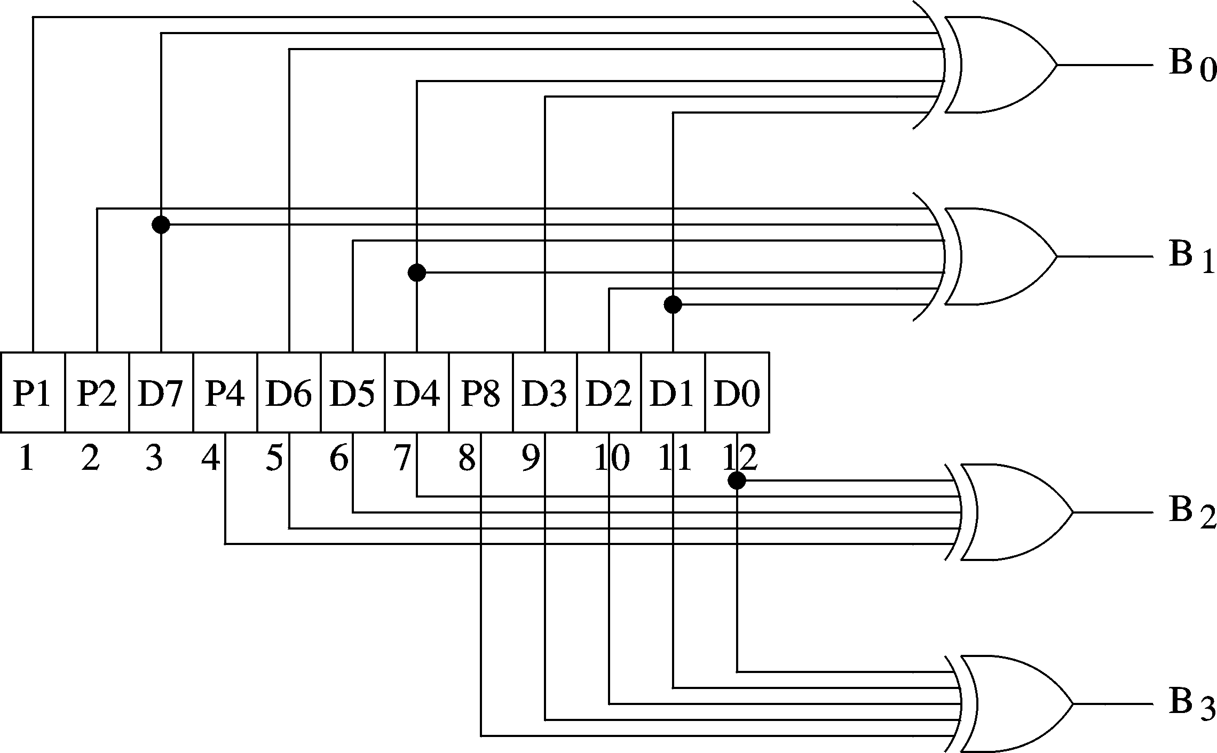
Error Detection and Correction (cont’d)
Circuit to identify error bit position
Chapter 19: Page <number>

Slide 30
Error Detection and Correction (cont’d)
SECDED
  Single-error correction and double error detection
    Often used in high-performance systems
  Previous scheme gives single-error detection and correction capability
  To incorporate double error detection
    Add an additional parity bit
      This bit is added as the leftmost bit P0 that is not used by the error correction scheme
    Example
      Previous example would have 8 data bits and 5 check bits for SECDED capability
Chapter 19: Page <number>

Slide 31
Error Detection and Correction (cont’d)
CRC
  Cyclic redundancy check
    Computed for a block of data
    Widely used to detect burst errors
    Uses fixed number of bits
      Mostly 16 or 32 bits depending on the block size
  Basic idea: If
        D
        ^{G}
        D−R
        G
    Based on integer division
= Q + R
= Q
Chapter 19: Page <number>

Slide 32
Error Detection and Correction (cont’d)
CRC uses a polynomial of degree n
  Example:
    USB polynomial for data packets
        x¹⁶ + x¹⁵ + x² + 1
    USB polynomial for token packets
        x⁵ + x² + 1
    Polynomial identifies the 1 bit positions
      USB data polynomial: 11000000000000101
      USB token polynomial: 100101
    Such polynomials are called polynomial generators
Chapter 19: Page <number>

Slide 33
Error Detection and Correction (cont’d)
A bit of theory behind CRC
      C = (d + n)-bit codeword
      D = d-bit data
      R = n-bit remainder (i.e., CRC code)
      G = degree n polynomial generator
  Goal: To generate C such that
    Remainder of (C/G) = 0
  Since we append n bits to the right
        C = D × 2^{n} ⊕ R
      ⊕ = XOR operation
Chapter 19: Page <number>

Slide 34
Error Detection and Correction (cont’d)
  We generate R as
        D × 2^{n} R
        G G
  Add the remainder R to generate the codeword
  When this codeword is divided by G, we get remainder as zero
        C D × 2^{n} ⊕ R
        G G
    From above, we get
        C R R R ⊕ R
        G G G G
= Q ⊕
=
zero
Error-free condition
= Q ⊕
⊕
= Q ⊕
= Q
Chapter 19: Page <number>

Slide 35
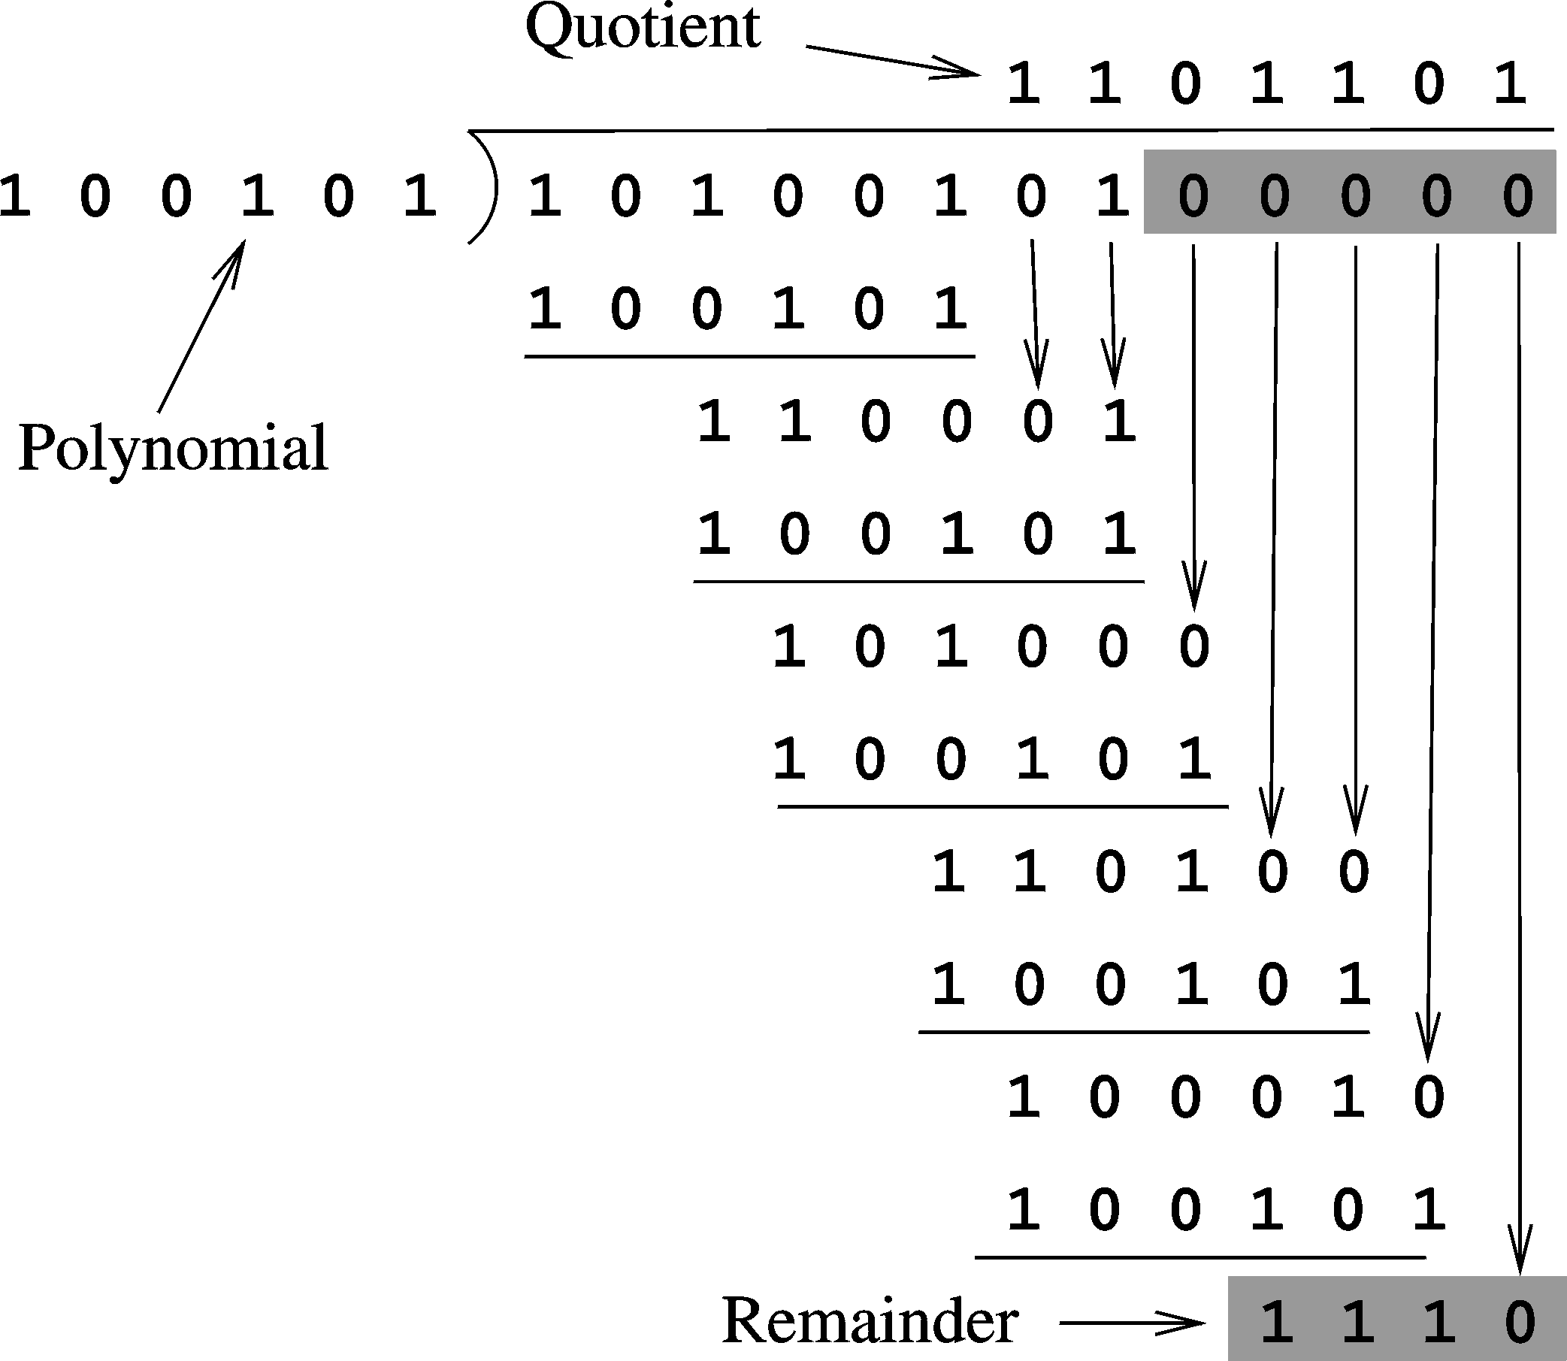
Error Detection and Correction (cont’d)
CRC calculation
for 10100101
Codeword is
1010010101110
Chapter 19: Page <number>

Slide 36
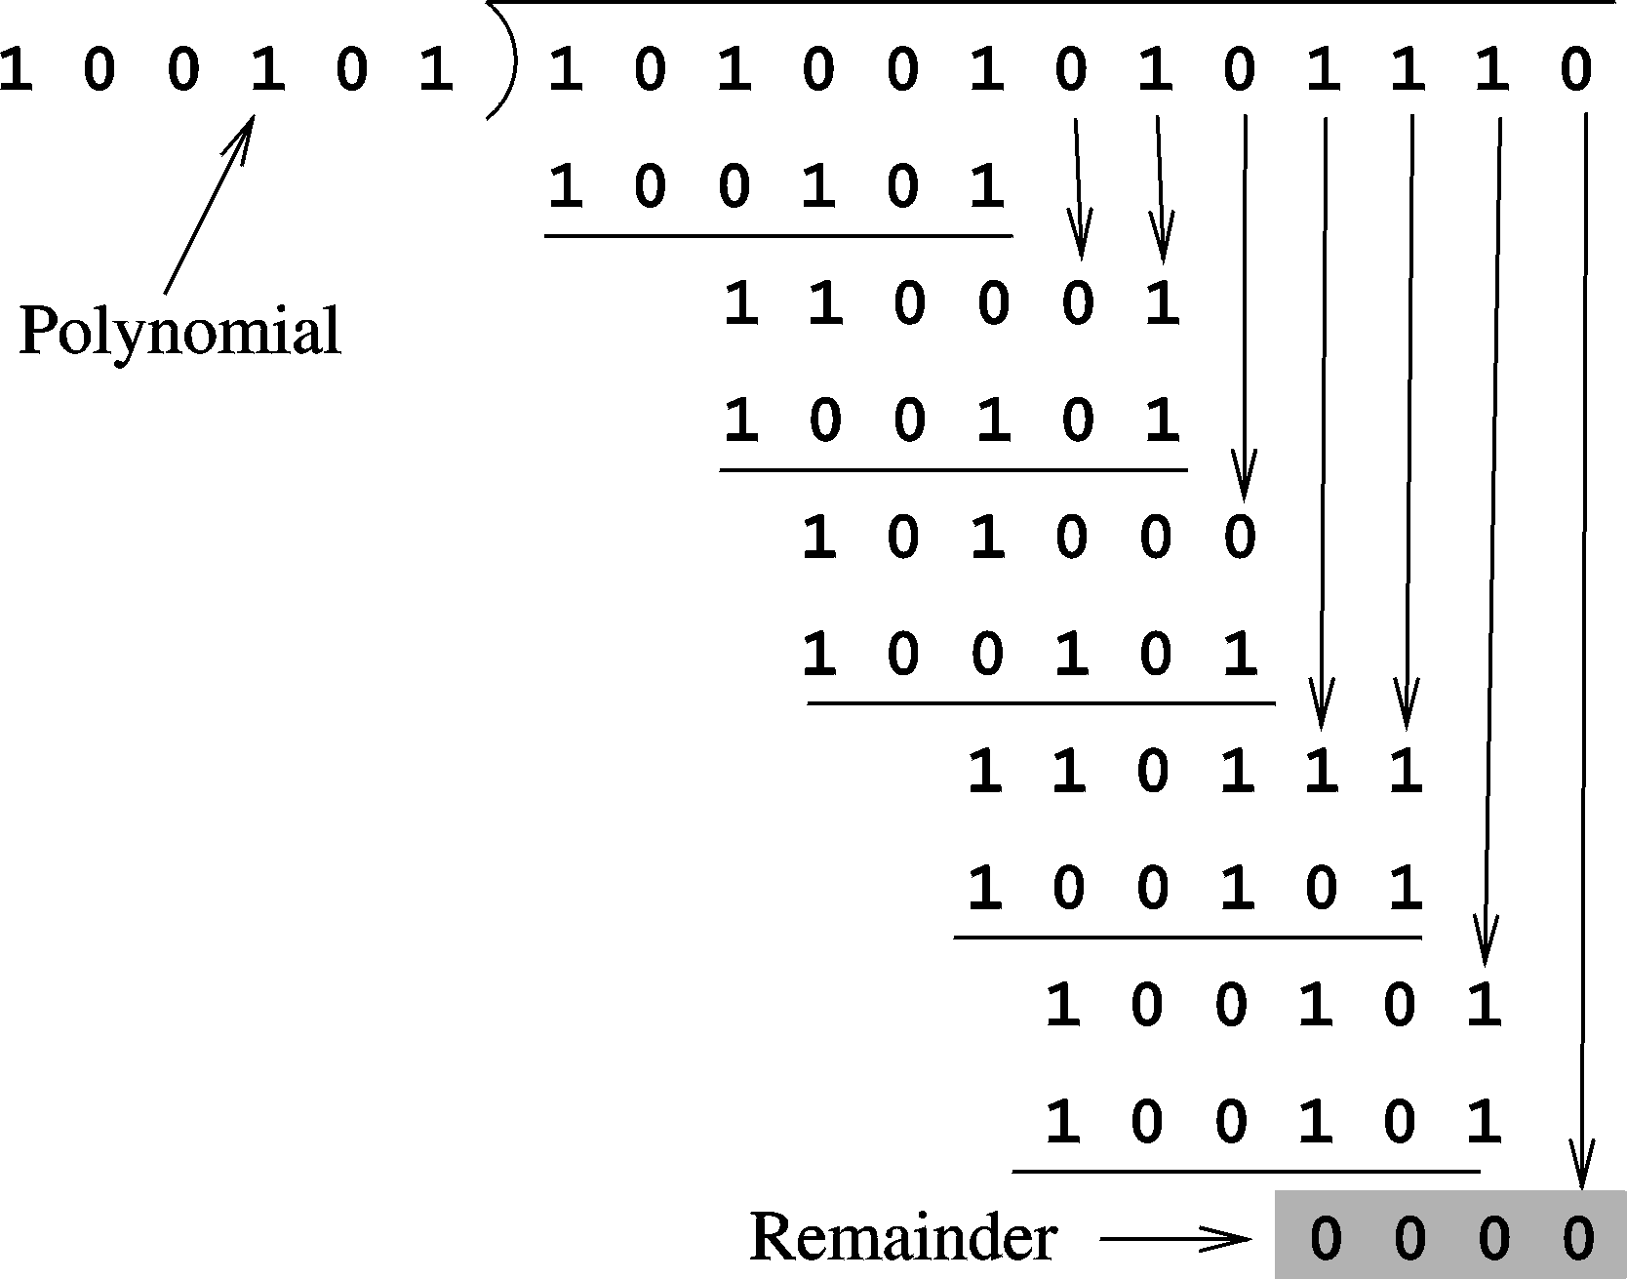
Error Detection and Correction (cont’d)
Error free message results in a zero remainder
Chapter 19: Page <number>

Slide 37
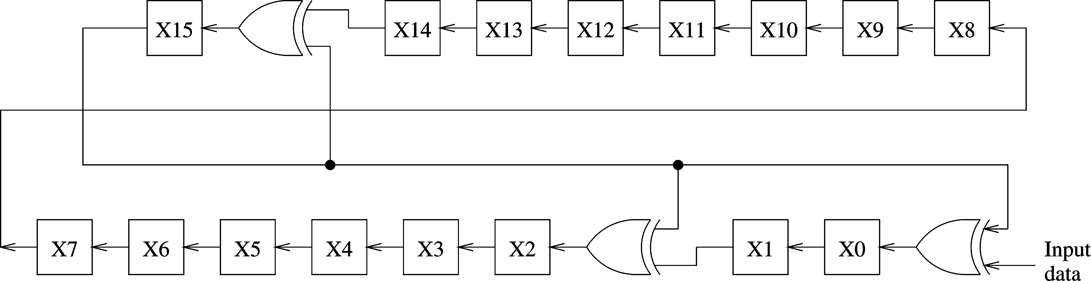
Error Detection and Correction (cont’d)
A serial CRC generator circuit
  Uses polynomial generator
      x¹⁶ + x¹⁵ + x² + 1
Chapter 19: Page <number>

Slide 38
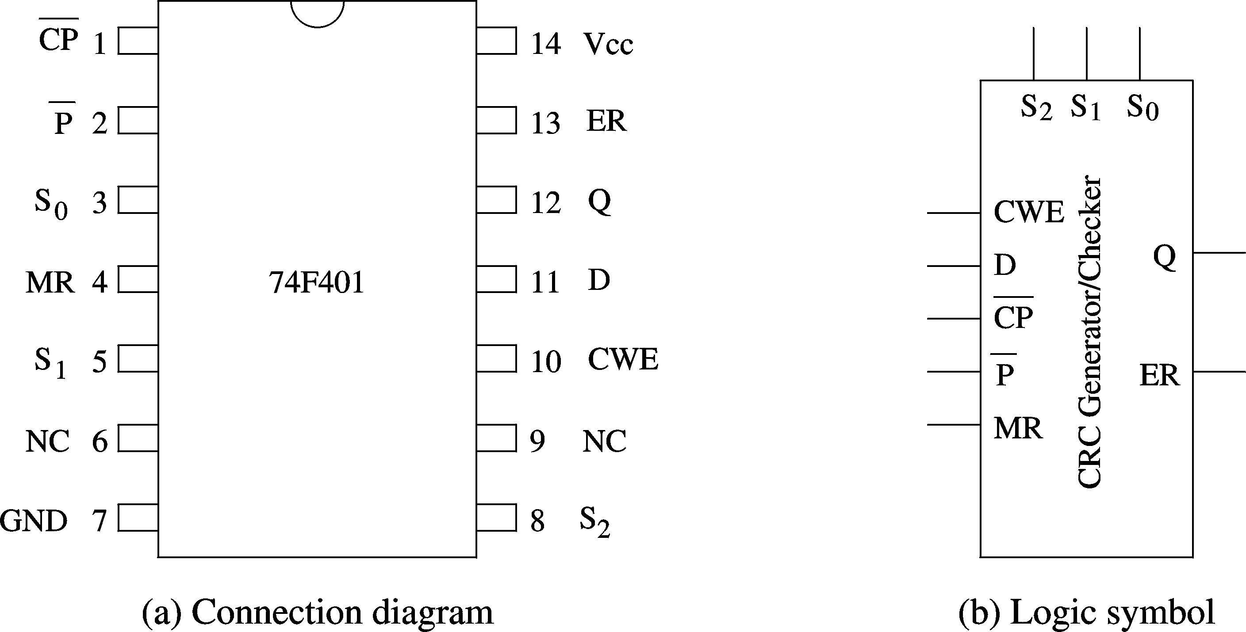
Error Detection and Correction (cont’d)
CRC generator/checker chip
Chapter 19: Page <number>

Slide 39
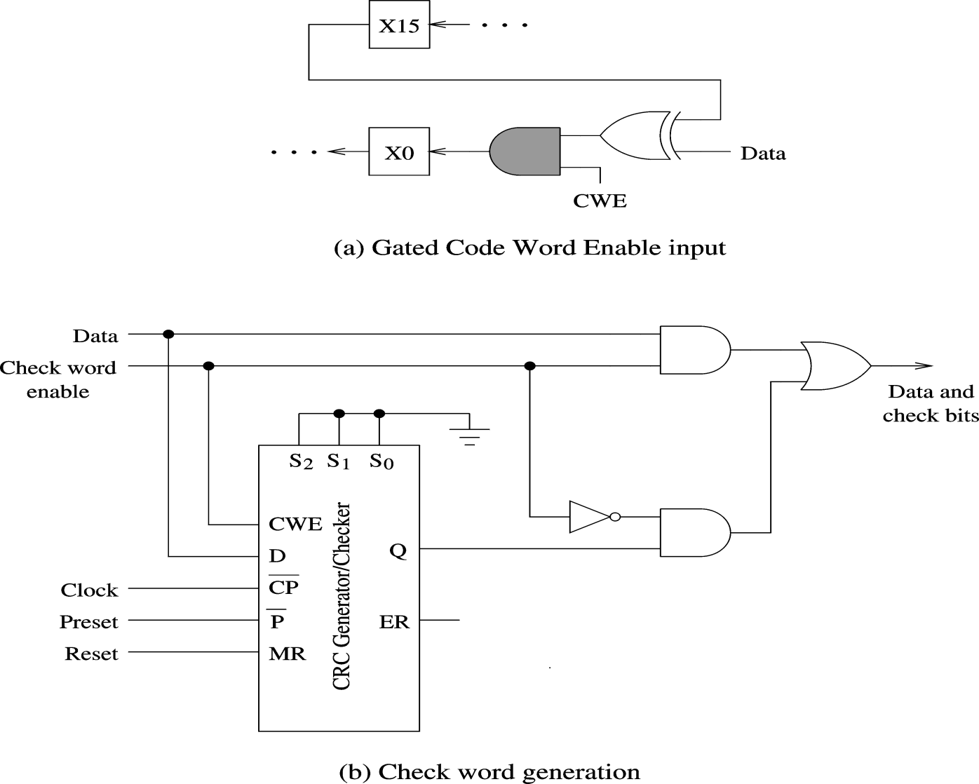
Error Detection and Correction (cont’d)
Using 74F401 to generate CRC for the generator
x¹⁶ + x¹⁵ + x² + 1
Chapter 19: Page <number>

Slide 40
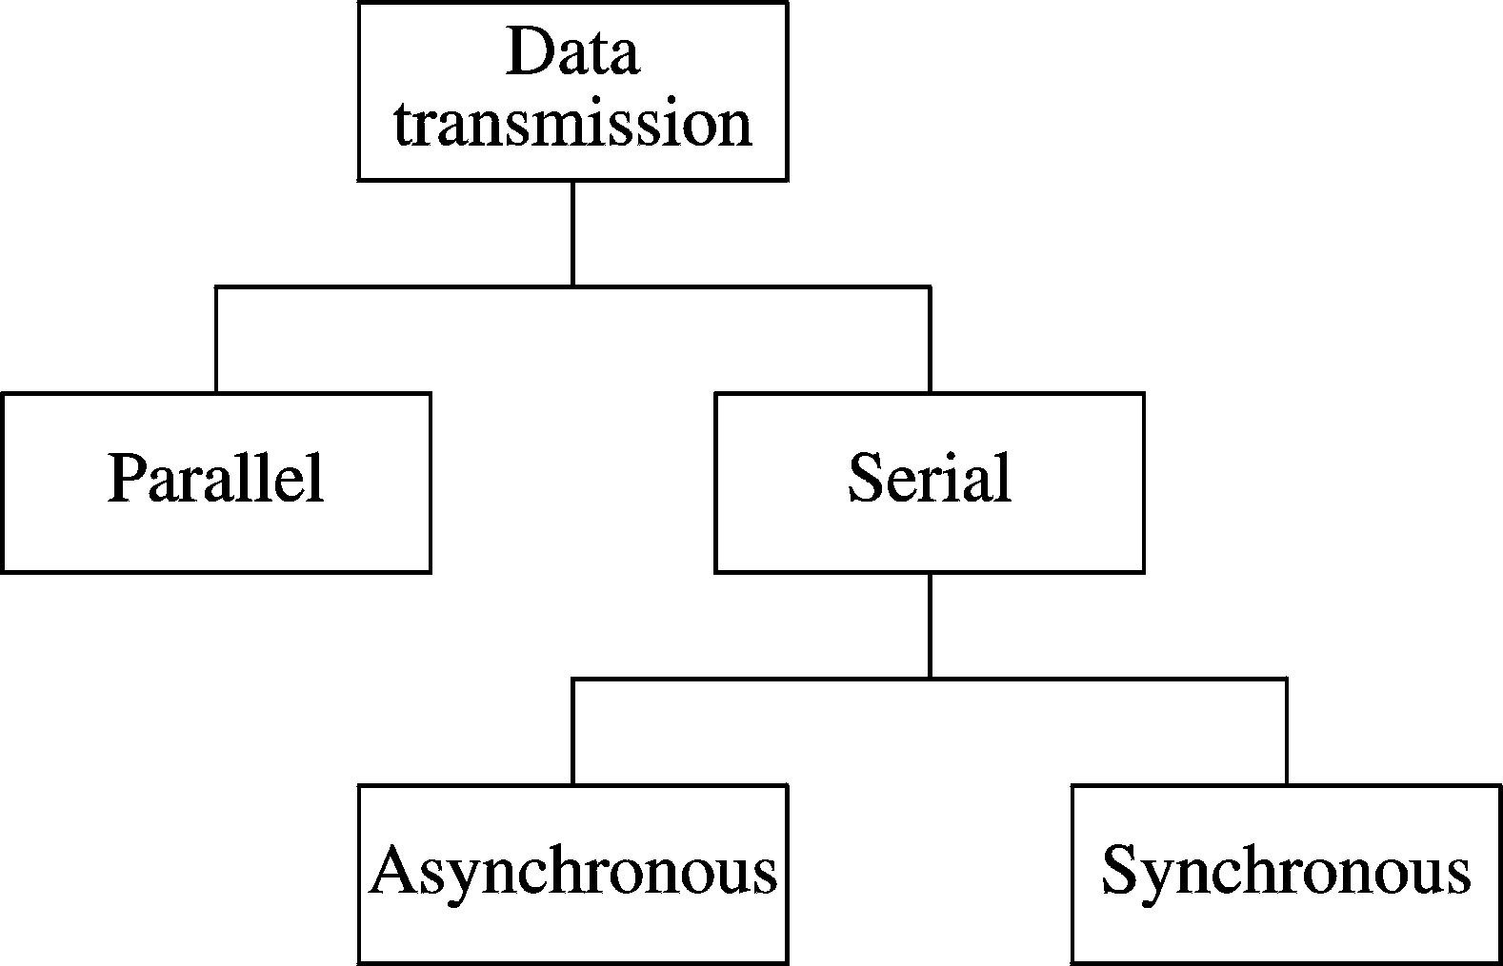
External Interface
Two ways of interfacing I/O devices
  Serial
    Cheaper
    Slower
  Parallel
    Faster
    Data skew
Limited to small distances
Chapter 19: Page <number>

Slide 41
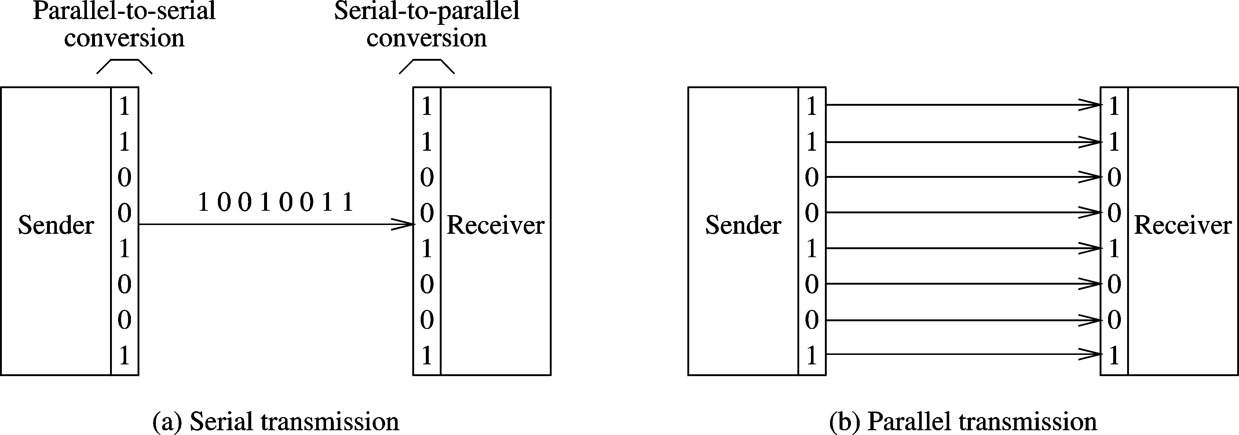
External Interface (cont’d)
Two basic modes of data transmission
Chapter 19: Page <number>

Slide 42
External Interface (cont’d)
Serial transmission
  Asynchronous
    Each byte is encoded for transmission
      Start and stop bits
    No need for sender and receiver synchronization
  Synchronous
    Sender and receiver must synchronize
      Done in hardware using phase locked loops (PLLs)
    Block of data can be sent
    More efficient
      Less overhead than asynchronous transmission
    Expensive
Chapter 19: Page <number>

Slide 43
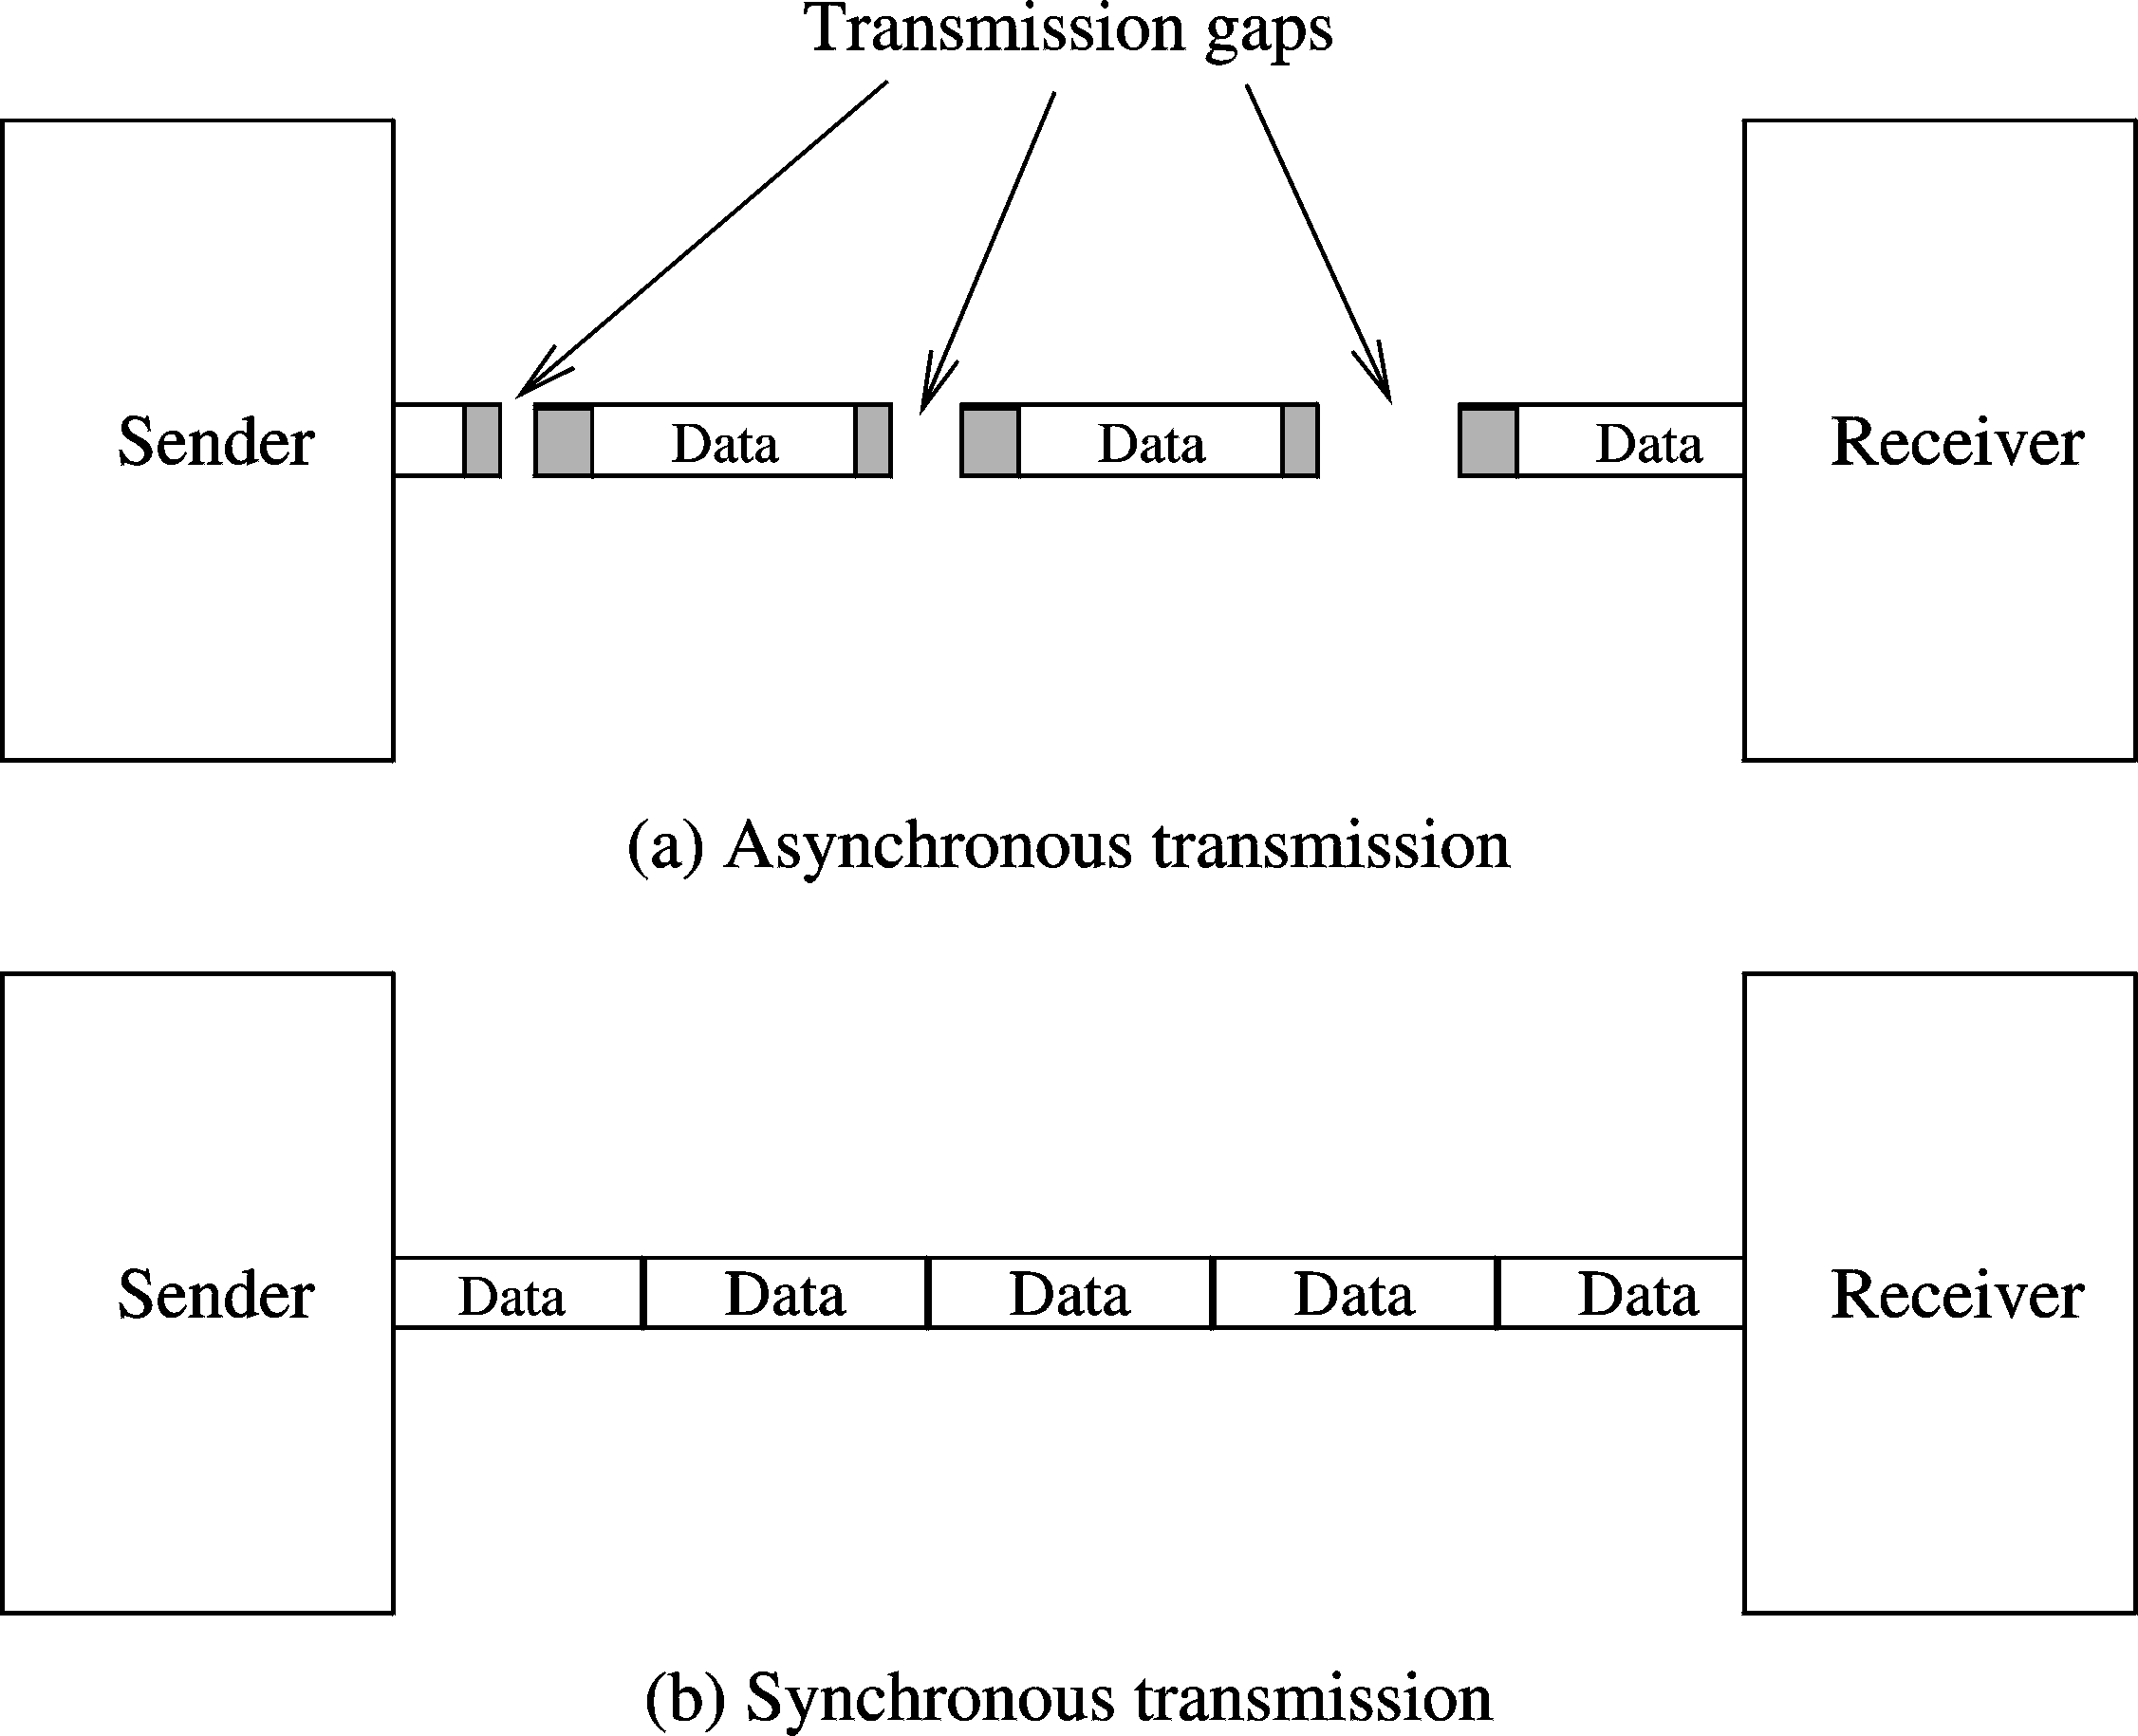
External Interface (cont’d)
Chapter 19: Page <number>

Slide 44
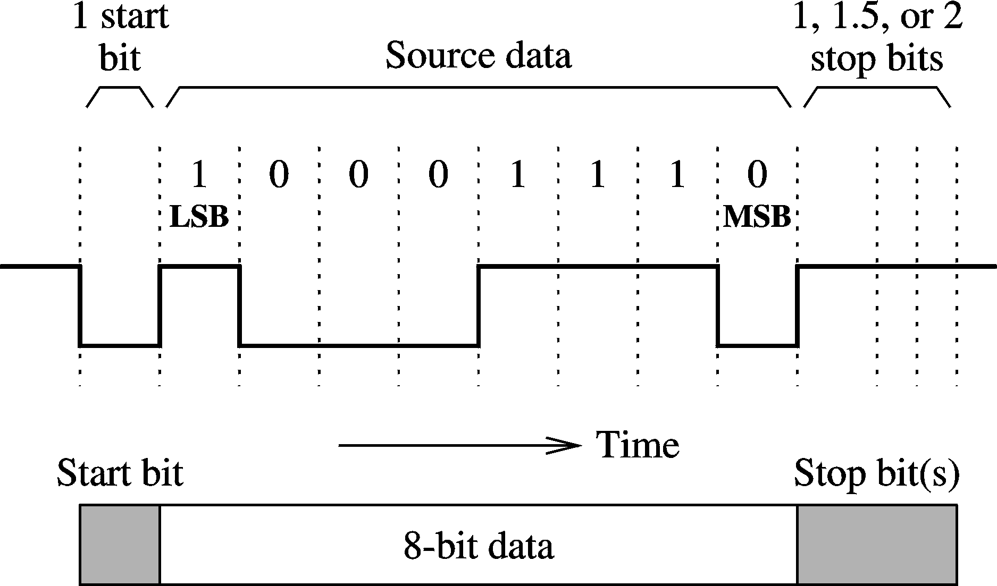
External Interface (cont’d)
Asynchronous transmission
Chapter 19: Page <number>

Slide 45
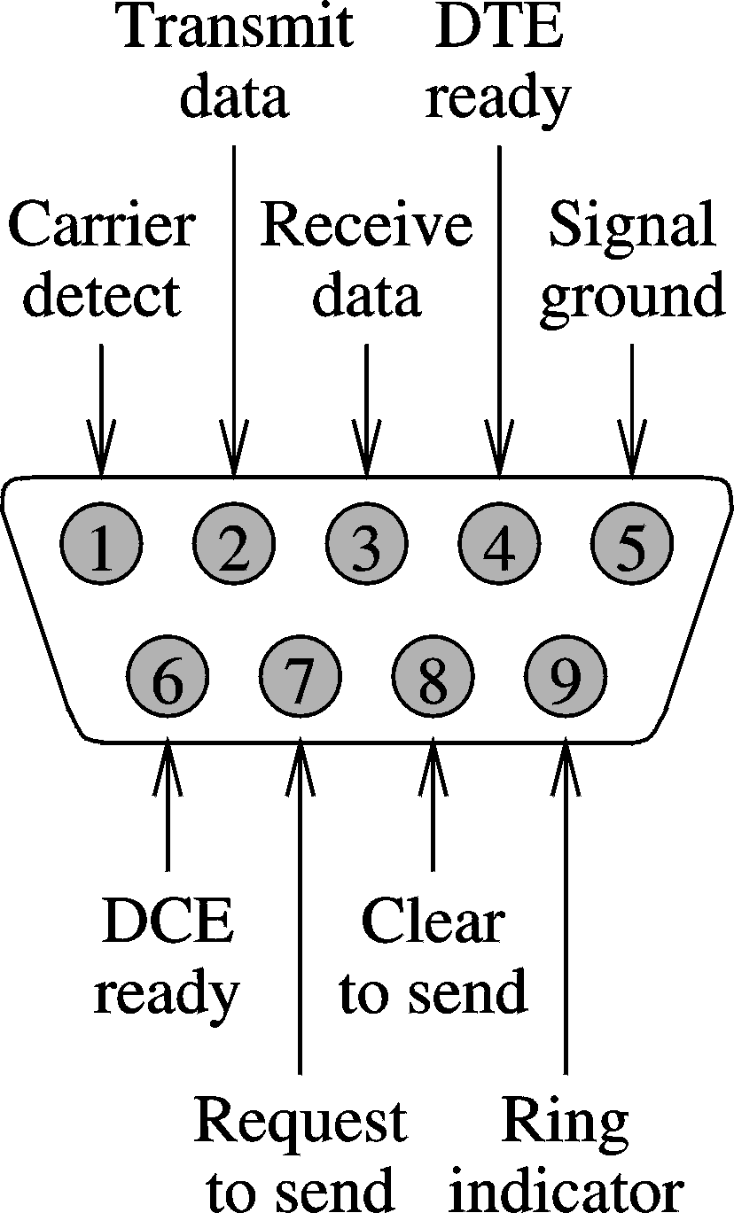
External Interface (cont’d)
EIA-232 serial interface
  Low-speed serial transmission
  Adopted by Electronics Industry Association (EIA)
    Popularly known by its predecessor RS-232
  It uses a 9-pin connector DB-9
    Uses 8 signals
  Typically used to connect a modem to a computer
Chapter 19: Page <number>

Slide 46
External Interface (cont’d)
Transmission protocol uses three phases
  Connection setup
    Computer A asserts DTE Ready
      Transmits phone# via Transmit Data line (pin 2)
    Modem B alerts its computer via Ring Indicator (pin 9)
      Computer B asserts DTE Ready (pin 4)
      Modem B generates carrier and turns its DCE Ready
    Modem A detects the carrier signal from modem B
      Modem A alters its computer via Carrier Detect (pin 1)
      Turns its DCE Ready
  Data transmission
    Done by handshaking using
      request-to-send (RTS) and clear-to-send (CTS) signals
  Connection termination
    Done by deactivating RTS
Chapter 19: Page <number>

Slide 47
External Interface (cont’d)
Parallel printer interface
  A simple parallel interface
  Uses 25-pin DB-25
    8 data signals
      Latched by strobe (pin 1)
    Data transfer uses simple handshaking
      Uses acknowledge (CK) signal
        After each byte, computer waits for ACK
    5 lines for printer status
      Busy, out-of-paper, online/offline, autofeed, and fault
    Can be initialized with INIT
      Clears the printer buffer and resets the printer
Chapter 19: Page <number>

Slide 48
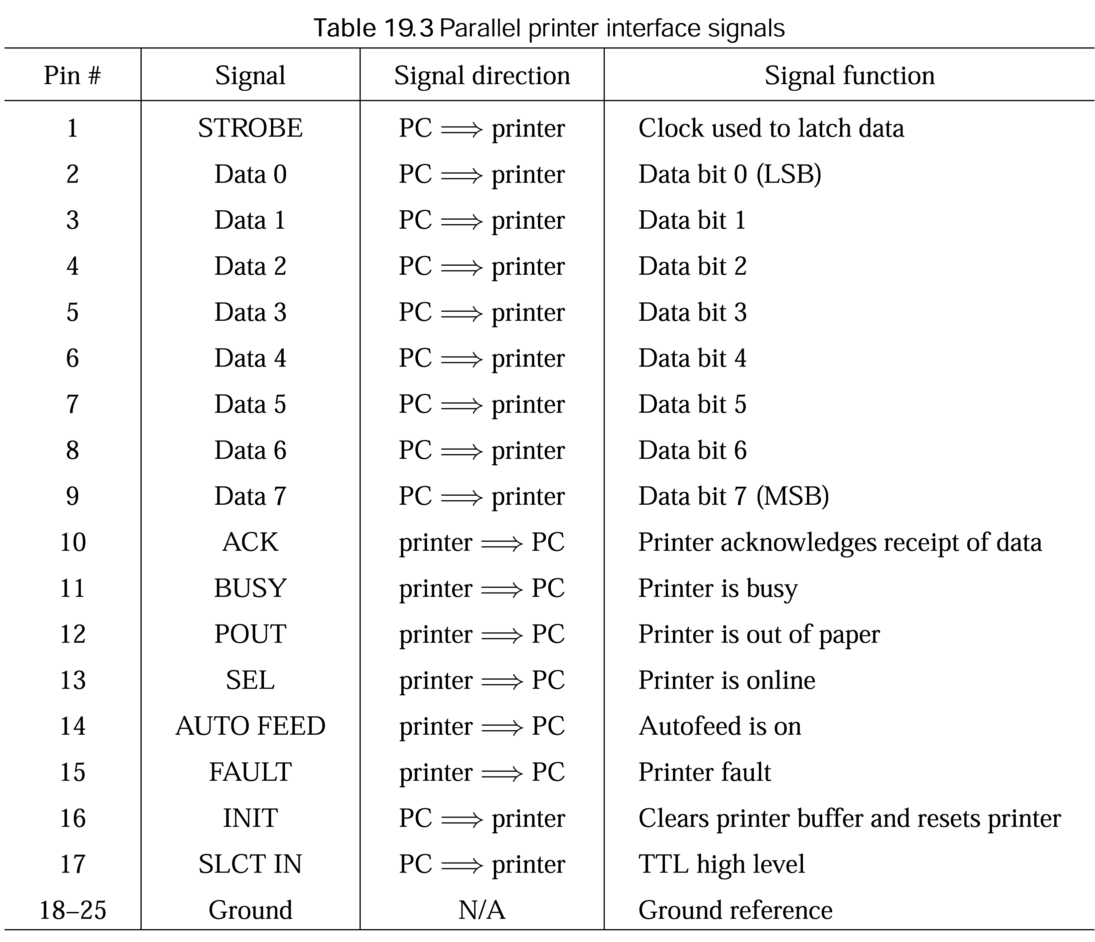
External Interface (cont’d)
Chapter 19: Page <number>

Slide 49
External Interface (cont’d)
SCSI
  Pronounced “scuzzy”
  Small Computer System Interface
    Supports both internal and external connection
  Comes in two bus widths
    8 bits
      Known as narrow SCSI
      Uses a 50-pin connector
      Device id can range from 0 to 7
    16 bits
      Known as wide SCSI
      Uses a 68-pin connector
      Device id can range from 0 to 15
Chapter 19: Page <number>

Slide 50
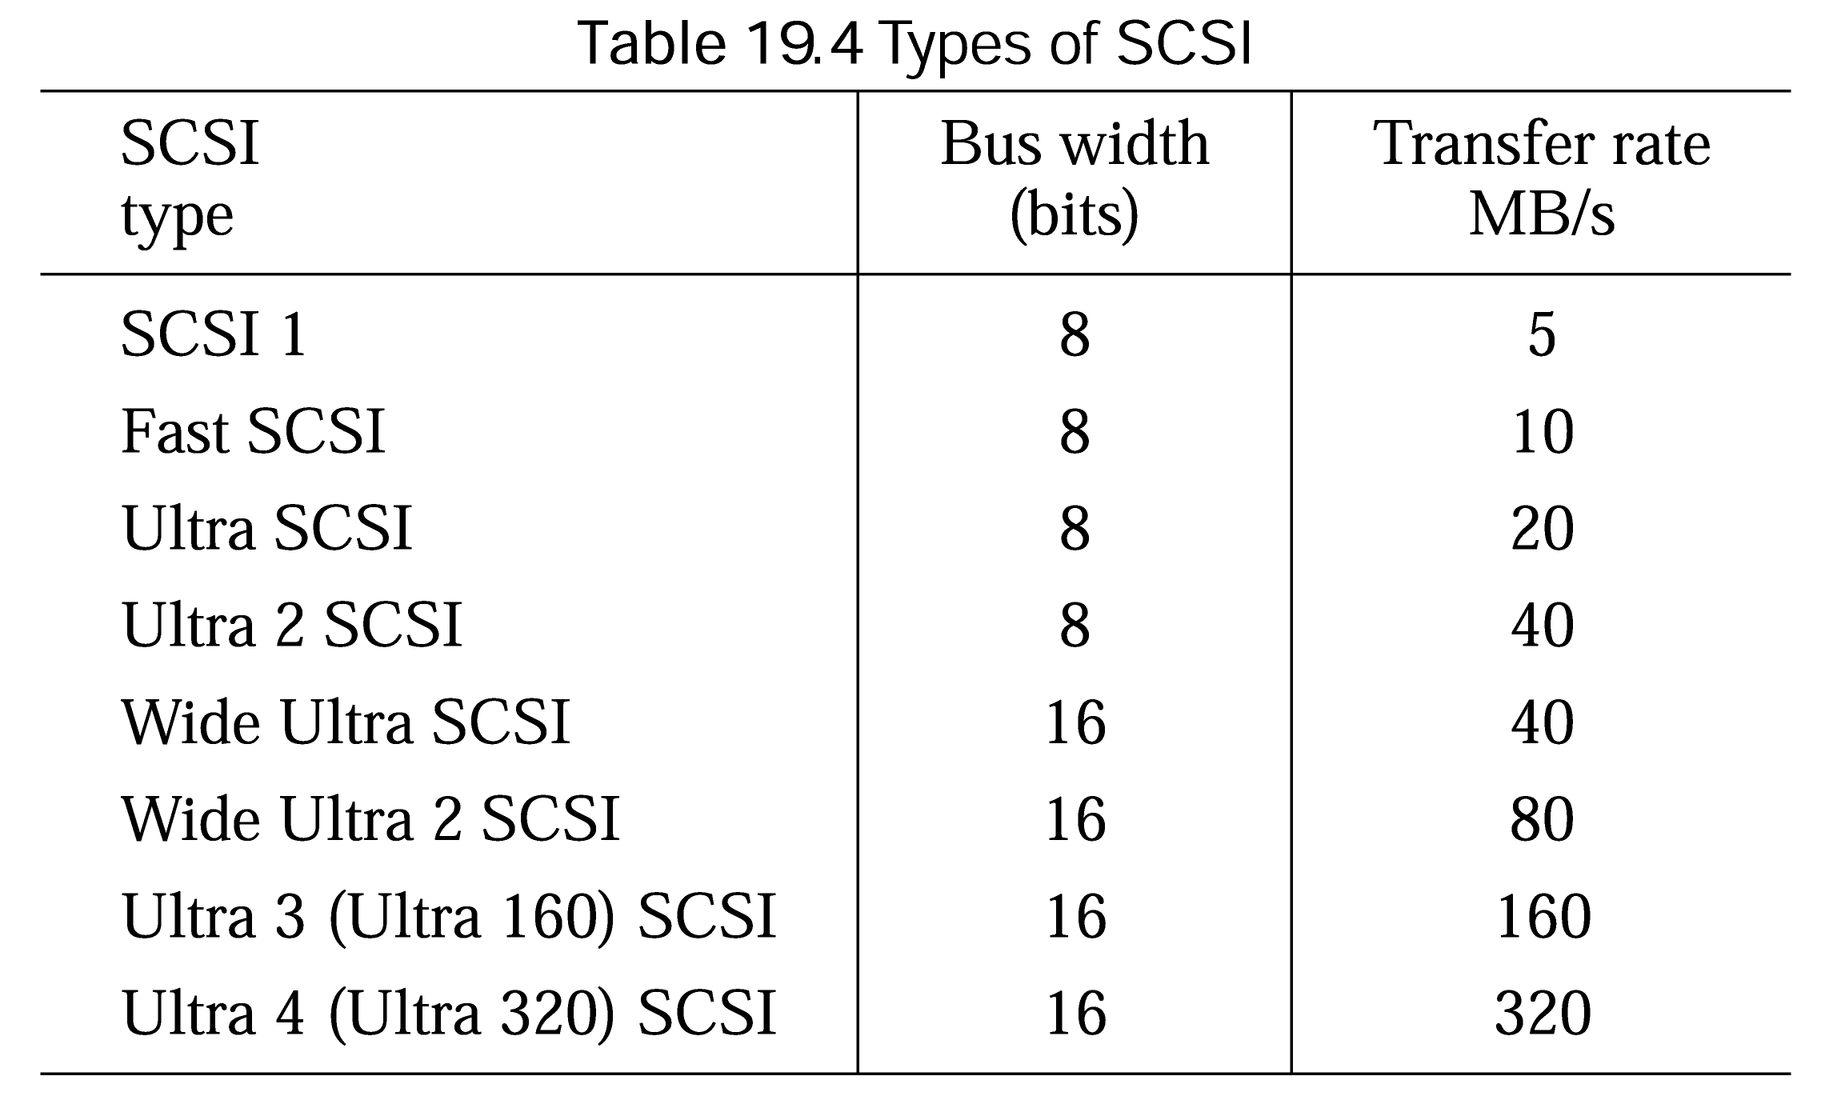
External Interface (cont’d)
Chapter 19: Page <number>

Slide 51
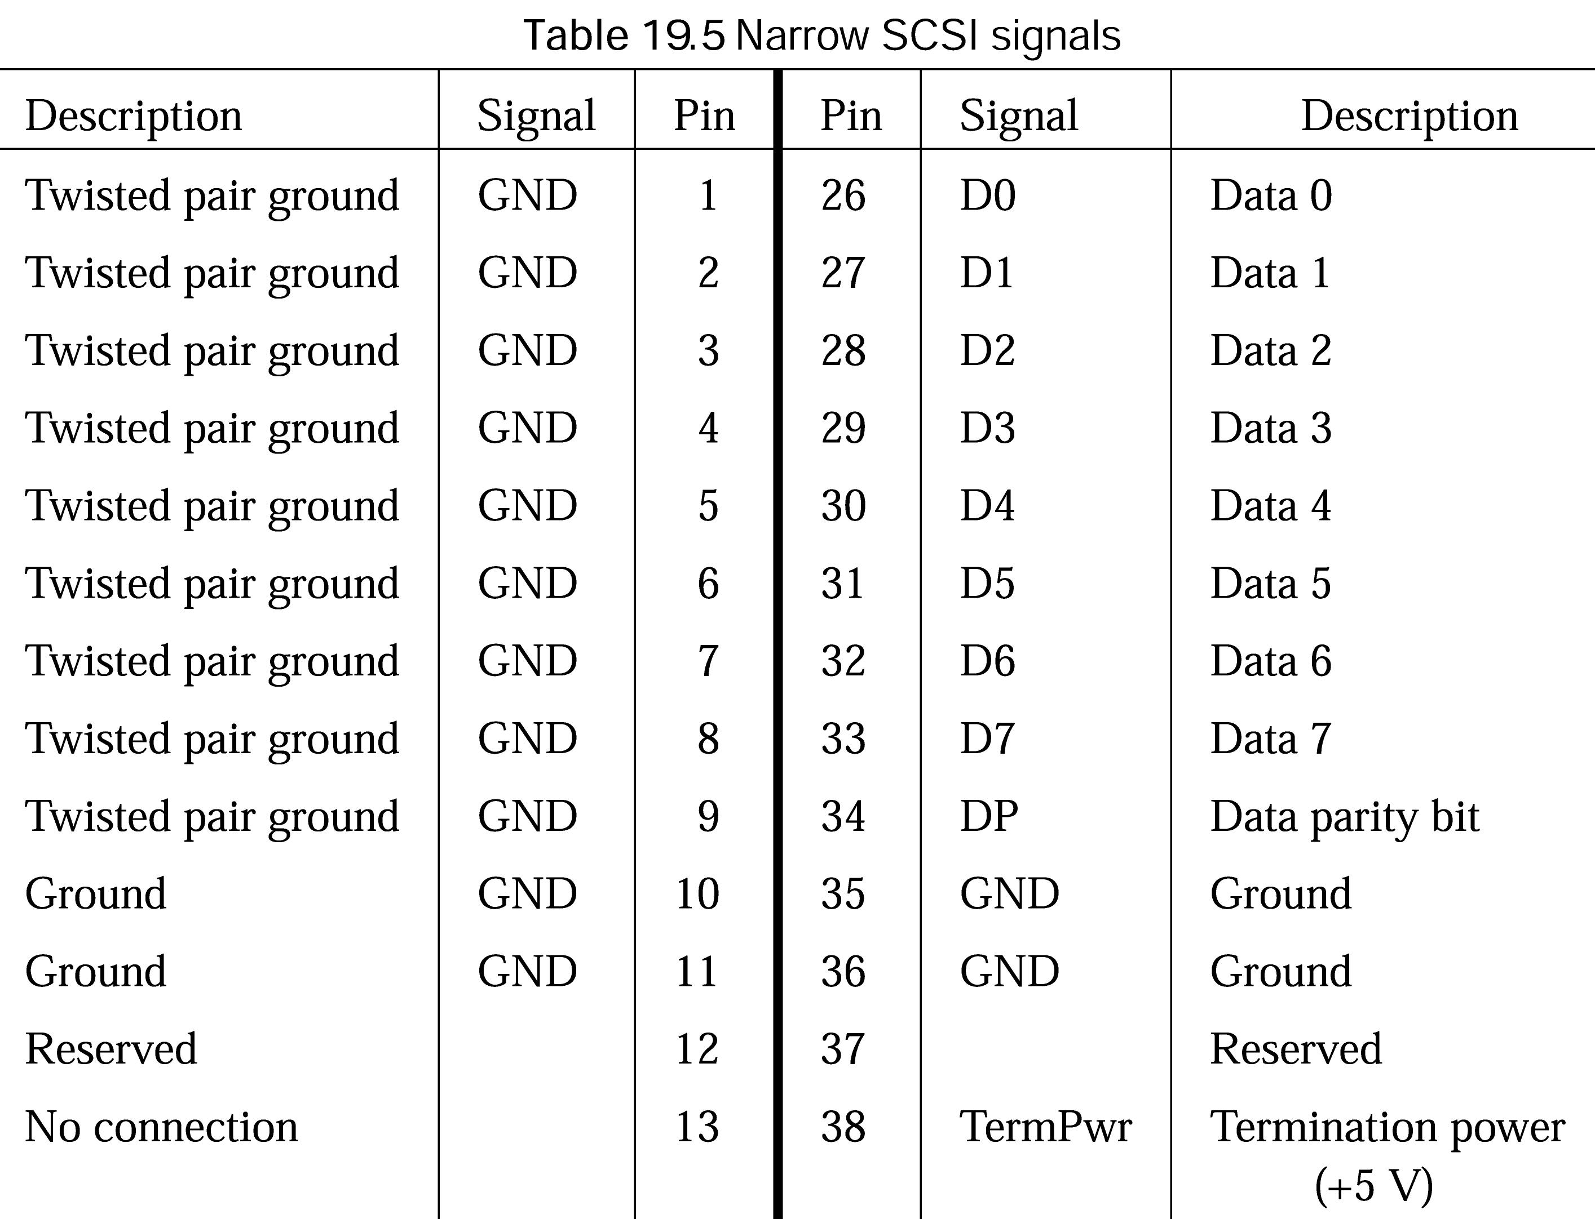
External Interface (cont’d)
cont’d
Chapter 19: Page <number>

Slide 52
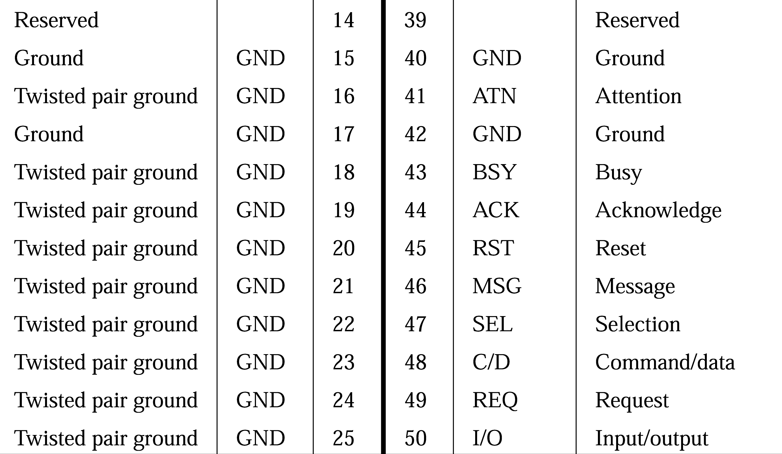
External Interface (cont’d)
Chapter 19: Page <number>

Slide 53
External Interface (cont’d)
SCSI uses client-server model
  Uses terms initiator and target for client and server
    Initiator issues commands to targets to perform a task
      Initiators are typically SCSI host adaptors
    Targets receive the command and perform the task
      Targets are SCSI devices like disk drives
SCSI transfer proceeds in phases
  Command
  Message in
  Message out
  Data in
  Data out
  Status
IN and OUT from the initiator point of view
Chapter 19: Page <number>

Slide 54
External Interface (cont’d)
  SCSI uses asynchronous mode for all bus negotiations
    Uses handshaking using REQ and ACK signals for each byte of data
  On a synchronous SCSI
    Data are transferred synchronously
    REQ-ACK signals are not used for each byte
    A number of bytes (e.g., 8) can be sent without waiting for ACK
      Improves throughput
      Minimizes adverse impact of cable propagation delay
Chapter 19: Page <number>

Slide 55
USB
Universal Serial Bus
  Originally developed in 1995 by a consortium including
    Compaq, HP, Intel, Lucent, Microsoft, and Philips
  USB 1.1 supports
    Low-speed devices (1.5 Mbps)
    Full-speed devices (12 Mbps)
  USB 2.0 supports
    High-speed devices
      Up to 480 Mbps (a factor of 40 over USB 1.1)
    Uses the same connectors
      Transmission speed is negotiated on device-by-device basis
Chapter 19: Page <number>

Slide 56
USB (cont’d)
Motivation for USB
  Avoid device-specific interfaces
    Eliminates multitude of interfaces
      PS/2, serial, parallel, monitor, microphone, keyboard,…
  Avoid non-shareable interfaces
    Standard interfaces support only one device
  Avoid I/O address space and IRQ problems
    USB does not require memory or address space
  Avoid installation and configuration problems
    Don’t have to open the box to install and configure jumpers
  Allow hot attachment of devices
Chapter 19: Page <number>

Slide 57
USB (cont’d)
Additional advantages of USB
  Power distribution
    Simple devices can be bus-powered
      Examples: mouse, keyboards, floppy disk drives, wireless LANs, …
  Control peripherals
    Possible because USB allows data to flow in both directions
  Expandable through hubs
  Power conservation
    Enters suspend state if there is no activity for 3 ms
  Error detection and recovery
    Uses CRC
Chapter 19: Page <number>

Slide 58
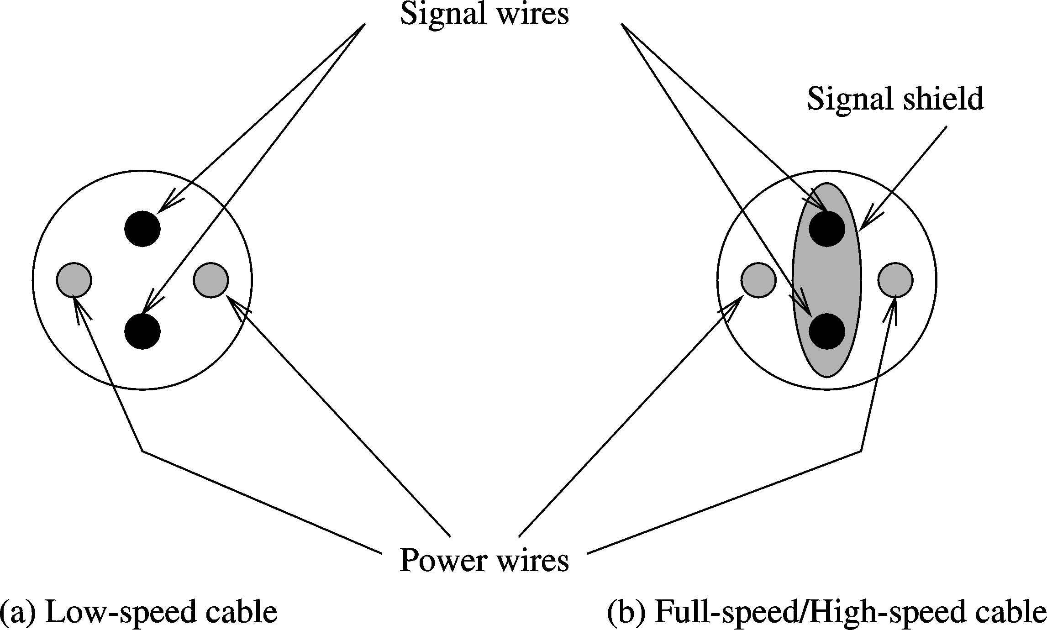
USB (cont’d)
USB cables
Chapter 19: Page <number>

Slide 59
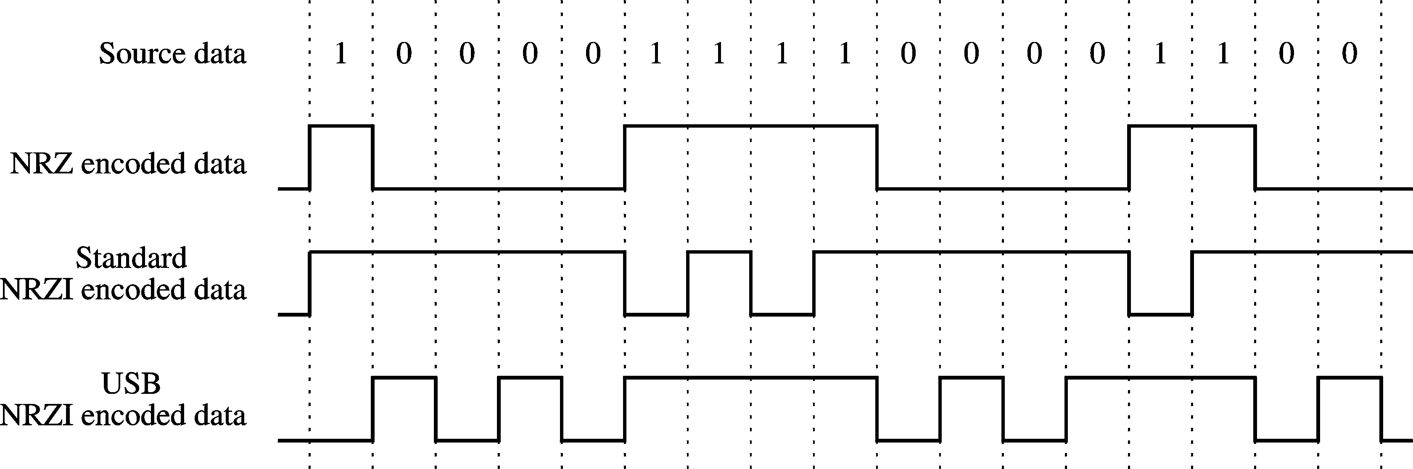
USB (cont’d)
USB encoding
  Uses NRZI encoding
    Non-Return to Zero-Inverted
Chapter 19: Page <number>

Slide 60
USB (cont’d)
NRZI encoding
  A signal transition occurs if the next bit is zero
    It is called differential encoding
  Two desirable properties
    Signal transitions, not levels, need to be detected
    Long string of zeros causes signal changes
  Still a problem
    Long strings of 1s do not causes signal change
  To solve this problem
    Uses bit stuffing
      A zero is inserted after every six consecutive 1s
Chapter 19: Page <number>

Slide 61
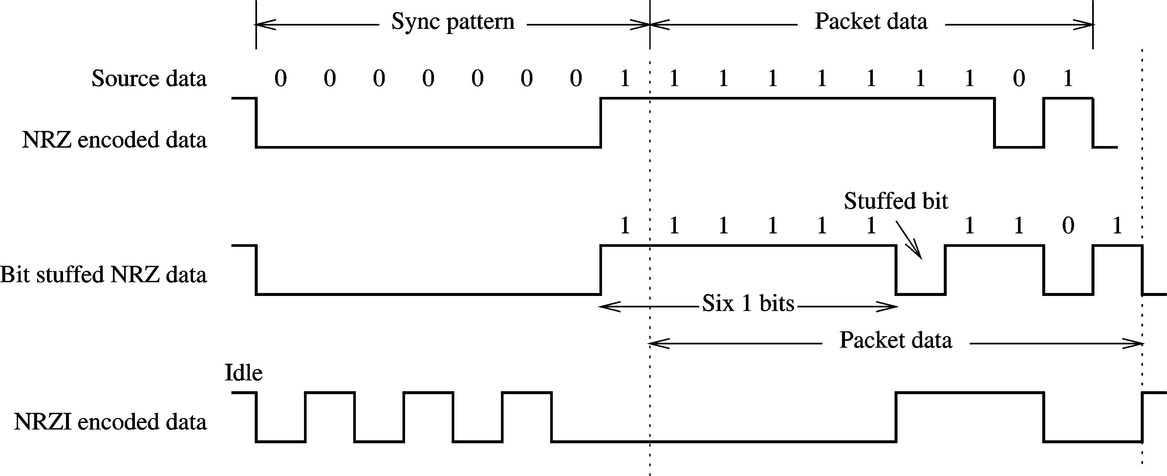
USB (cont’d)
Bit stuffing
Chapter 19: Page <number>

Slide 62
USB (cont’d)
Transfer types
    Four types of transfer
  Interrupt transfer
    Uses polling
      Polling interval can range from 1 ms to 255 ms
  Isochronous transfer
    Used in real-time applications that require constant data transfer rate
      Example: Reading audio from CD-ROM
    These transfers are scheduled regularly
    Do not use error detection and recovery
Chapter 19: Page <number>

Slide 63
USB (cont’d)
  Control transfer
    Used to configure and set up USB devices
    Three phases
      Setup stage
        Conveys type of request made to target device
      Data stage
        Optional stage
        Control transfers that require data use this stage
      Status stage
        Checks the status of the operation
    Allocates a guaranteed bandwidth of 10%
    Error detection and recovery are used
      Recovery is by means of retries
Chapter 19: Page <number>

Slide 64
USB (cont’d)
  Bulk transfer
    For devices with no specific data transfer rate requirements
      Example: sending data to a printer
    Lowest priority bandwidth allocation
    If the other three types of transfers take 100% of the bandwidth
      Bulk transfers are deferred until load decreases
    Error detection and recovery are used
      Recovery is by means of retries
Chapter 19: Page <number>

Slide 65
USB (cont’d)
USB architecture
  USB host controller
    Initiates transactions over USB
  Root hub
    Provides connection points
  Two types of host controllers
    Open host controller (OHC)
      Defined by Intel
    Universal host controller (UHC)
      Specified by National Semiconductor, Microsoft, Compaq
    Difference between the two
      How they schedule the four types of transfers
Chapter 19: Page <number>

Slide 66
USB (cont’d)
UHC scheduling
  Schedules periodic transfers first
    Periodic transfers: isochronous and interrupts
    Can take up to 90% of bandwidth
  These transfers are followed by control and bulk transfers
    Control transfers are guaranteed 10% of bandwidth
  Bulk transfers are scheduled only if there is bandwidth available
Chapter 19: Page <number>

Slide 67
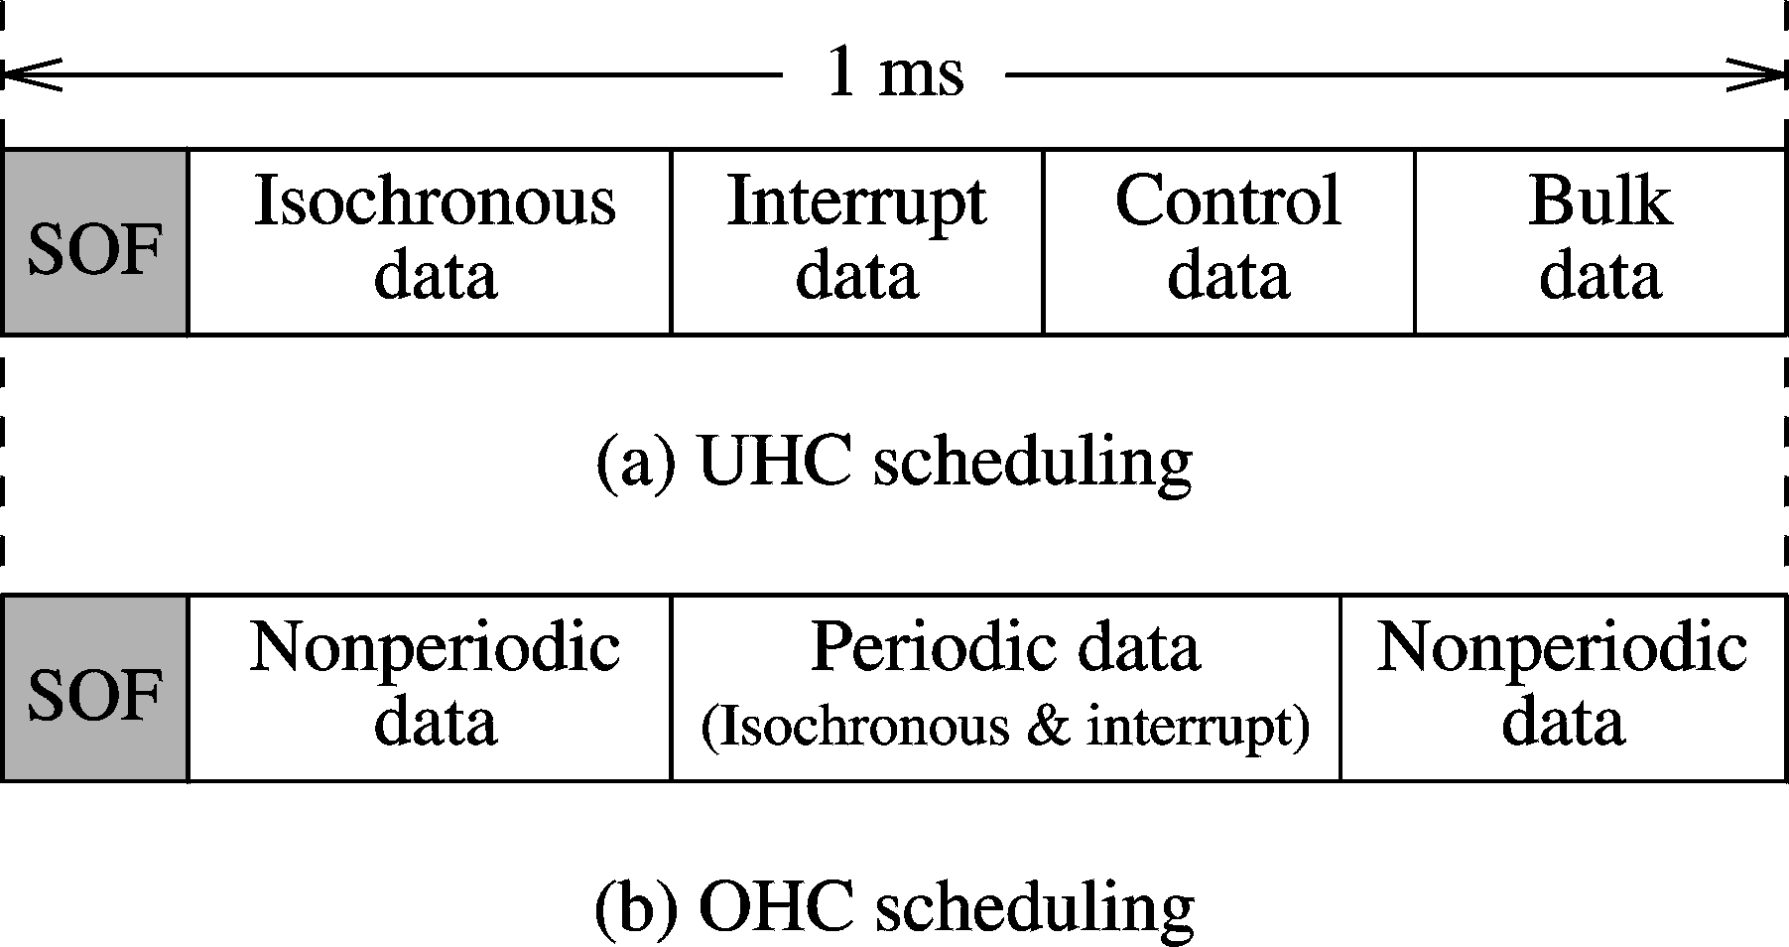
USB (cont’d)
Chapter 19: Page <number>

Slide 68
USB (cont’d)
OHC scheduling
  Different from UHC scheduling
  Reserves space for non-periodic transfers first
    Non-periodic transfers: control and bulk
    10% bandwidth reserved
  Next periodic transfers are scheduled
    Guarantees 90% bandwidth
  Left over bandwidth is allocated to non-periodic transfers
Chapter 19: Page <number>

Slide 69
USB (cont’d)
Bus powered devices
  Low-power
    Less than 100 mA
    Can be bus-powered
  High-powered
    Between 100 mA and 500 mA
      Full-powered ports can power these devices
    Can be designed to have their own power
    Operate in three modes
      Configured (500 mA)
      Unconfigured (100 mA)
      Suspended ( about 2.5 mA)
Chapter 19: Page <number>

Slide 70
USB (cont’d)
USB hubs
  Bus-powered
    No extra power supply required
    Must be connected to an upstream port that can supply 500 mA
    Downstream ports can only supply 100 mA
      Number of ports is limited to four
      Support only low-powered devices
  Self-powered
    Support 4 high-powered devices
    Support 4 bus-powered USB hubs
  Most 4-port hubs are dual-powered
Chapter 19: Page <number>

Slide 71
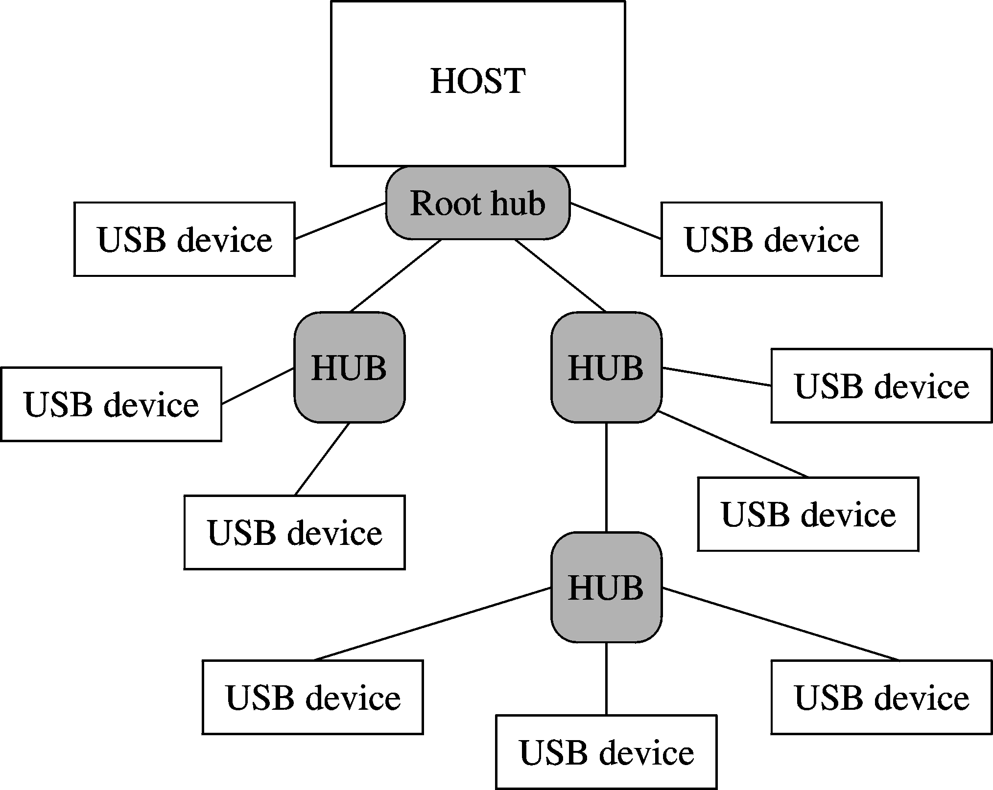
USB (cont’d)
Hubs can be used to expand
Upstream port
Downstream ports
Chapter 19: Page <number>

Slide 72
USB (cont’d)
USB transactions
  Transfers are done in one or more transactions
    Each transaction consists of several packets
  Transactions may have between 1 and 3 phases
    Token packet phase
      Specifies transaction type and target device address
    Data packet phase (optional)
      Maximum of 1023 bytes are transferred
    Handshake packet phase
      Except for isochronous transfers, others use error detection for guaranteed delivery
      Provides feedback on whether data has been received without error
Chapter 19: Page <number>

Slide 73
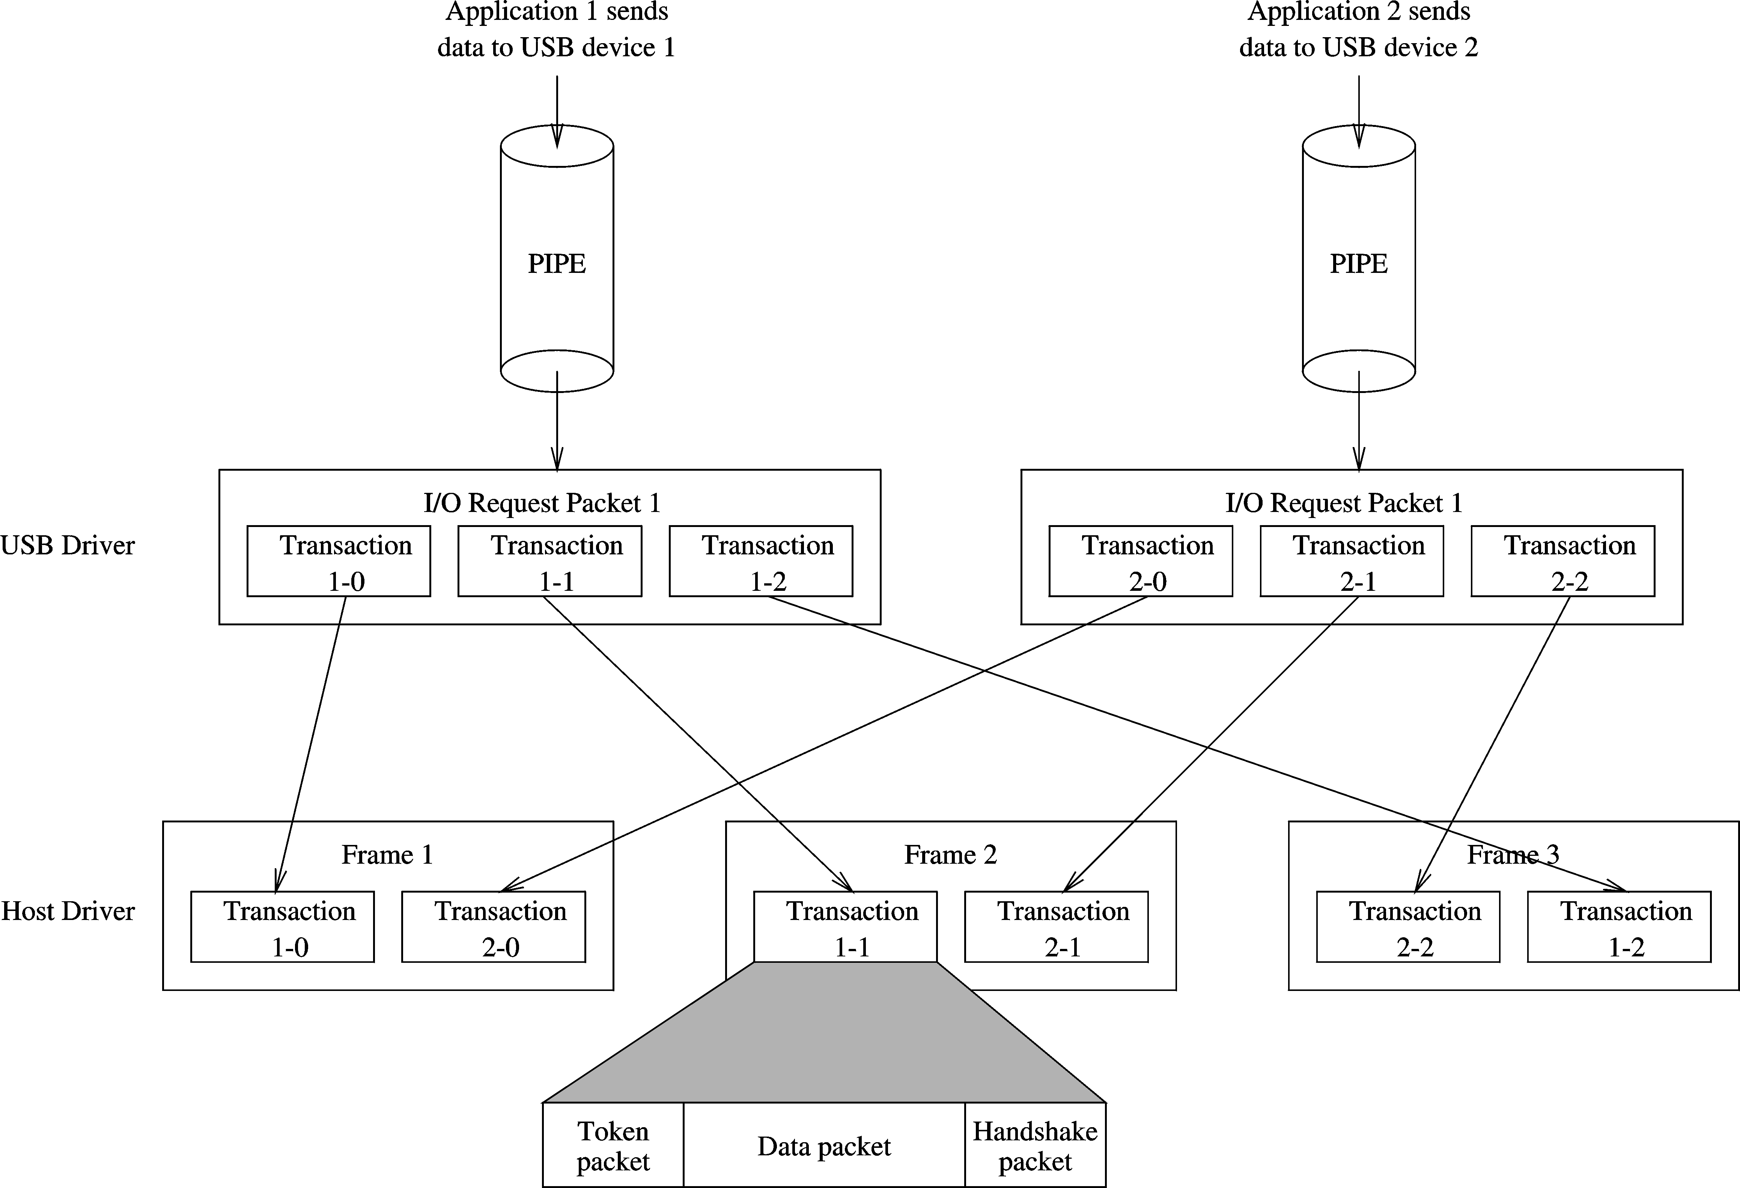
USB (cont’d)
USB IRP frame
Chapter 19: Page <number>

Slide 74
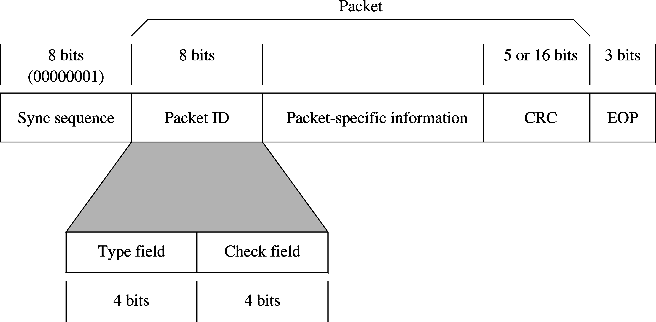
USB (cont’d)
Token packets use CRC-5
Hardware encoded special pattern
Specifies token, data, or handshake packet
Complement of type field
Chapter 19: Page <number>

Slide 75
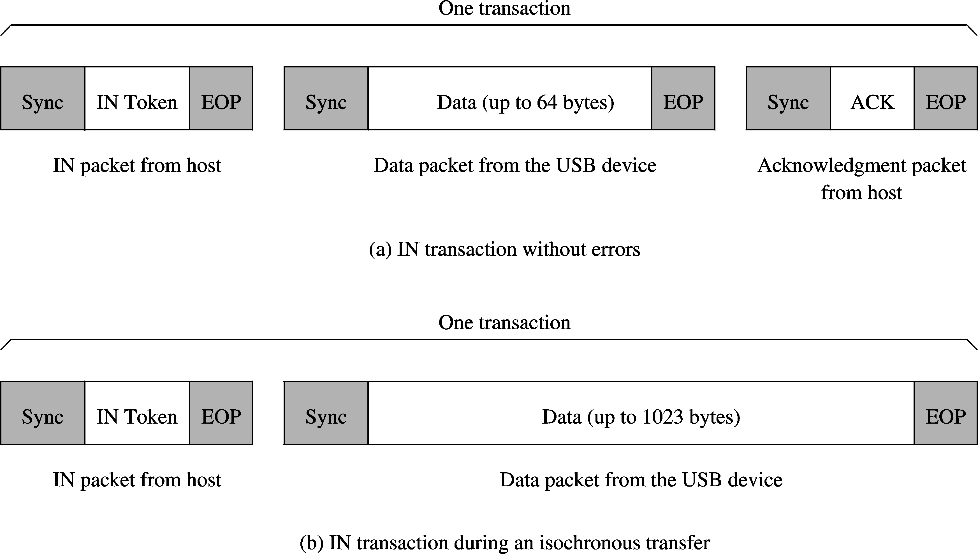
USB (cont’d)
USB 1.1 transactions
Chapter 19: Page <number>

Slide 76
USB (cont’d)
USB 2.0
  USB 1.1 uses 1 ms frames
  USB 2.0 uses 125 μs frames
    1/8 of USB 1.1
  Supports 40X data rates
    Up to 480 Mbps
  Competitive with
    SCSI
    IEEE 1394 (FireWire)
  Widely available now
Chapter 19: Page <number>

Slide 77
IEEE 1394
Apple originally developed this standard for high-speed peripherals
  Known by a variety of names
    Apple: FireWire
    Sony: i.ILINK
  IEEE standardized it as IEEE 1394
    First released in 1995 as IEEE 1394-1995
    A slightly revised version as 1394a
    Next version 1394b
  Shares many of the features of USB
Chapter 19: Page <number>

Slide 78
IEEE 1394 (cont’d)
Advantages
  High speed
    Supports three speeds
      100, 200, 400 Mbps
        Competes with USB 2.0
      Plans to boost it to 3.2 Gbps
  Hot attachment
    Like USB
    No need to shut down power to attach devices
  Peer-to-peer support
    USB is processor-centric
    Supports peer-to-peer communication without involving the processor
Chapter 19: Page <number>

Slide 79
IEEE 1394 (cont’d)
  Expandable bus
    Devices can be connected in daisy-chain fashion
    Hubs can used to expand
  Power distribution
    Like the USB, cables distribute power
      Much higher power than USB
        Voltage between 8 and 33 V
        Current an be up to 1.5 Amps
  Error detection and recovery
    As in USB, uses CRC
    Uses retransmission in case of error
  Long cables
    Like the USB
Chapter 19: Page <number>

Slide 80
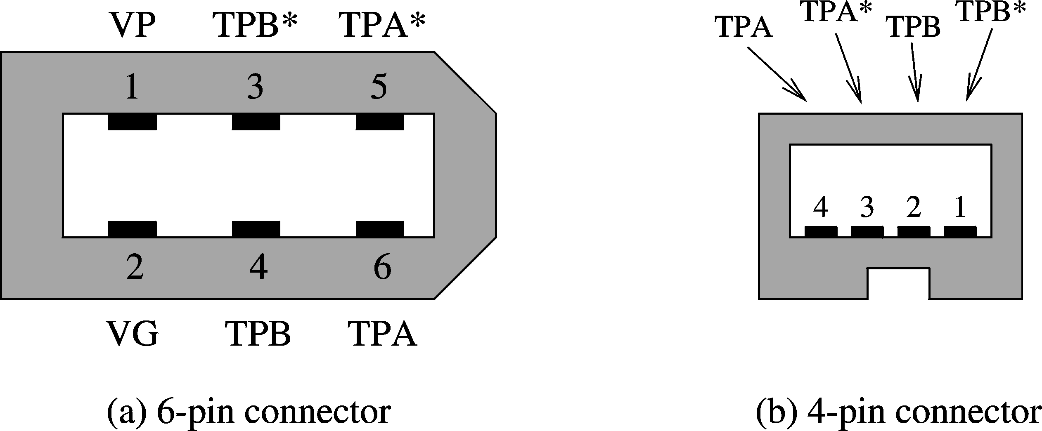
IEEE 1394 (cont’d)
IEEE 1394 6-pin and 4-pin connectors
4-pin connector does not distribute power
Chapter 19: Page <number>

Slide 81
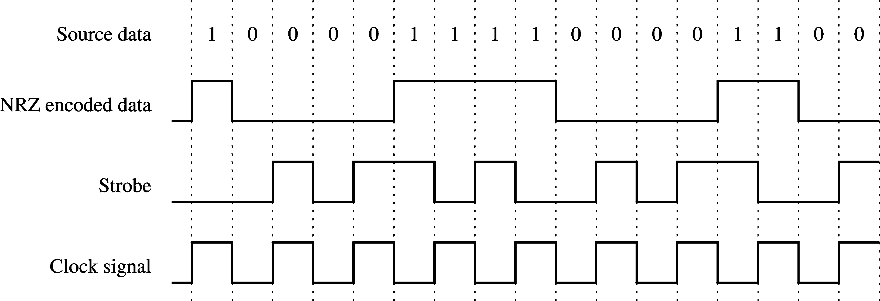
IEEE 1394 (cont’d)
Encoding
  Uses a simple NRZ encoding
  Strobe signal is encoded
    Changes the signal even if successive bits are the same
Chapter 19: Page <number>

Slide 82
IEEE 1394 (cont’d)
Transfer types
  Asynchronous
    For applications that require correct delivery of data
      Example: writing a file to a disk drive
    Uses an acknowledgement to confirm delivery
    Guaranteed bandwidth of 20%
  Isochronous
    For real-time applications
    No acknowledgement
    Up to 80% of bandwidth allocated
  Bandwidth allocation on a cycle-by-cycle basis
    Cycle time: 125 μs
Chapter 19: Page <number>

Slide 83
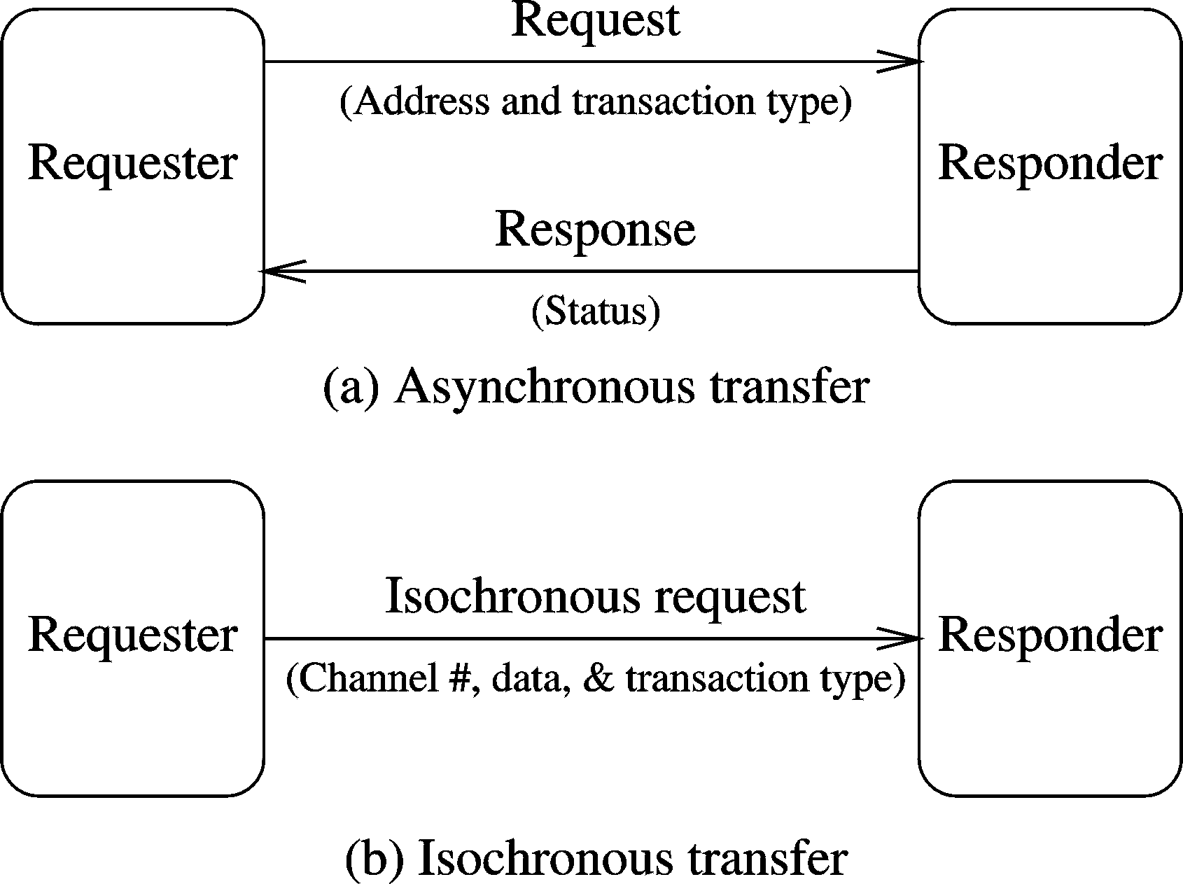
IEEE 1394 (cont’d)
Chapter 19: Page <number>

Slide 84
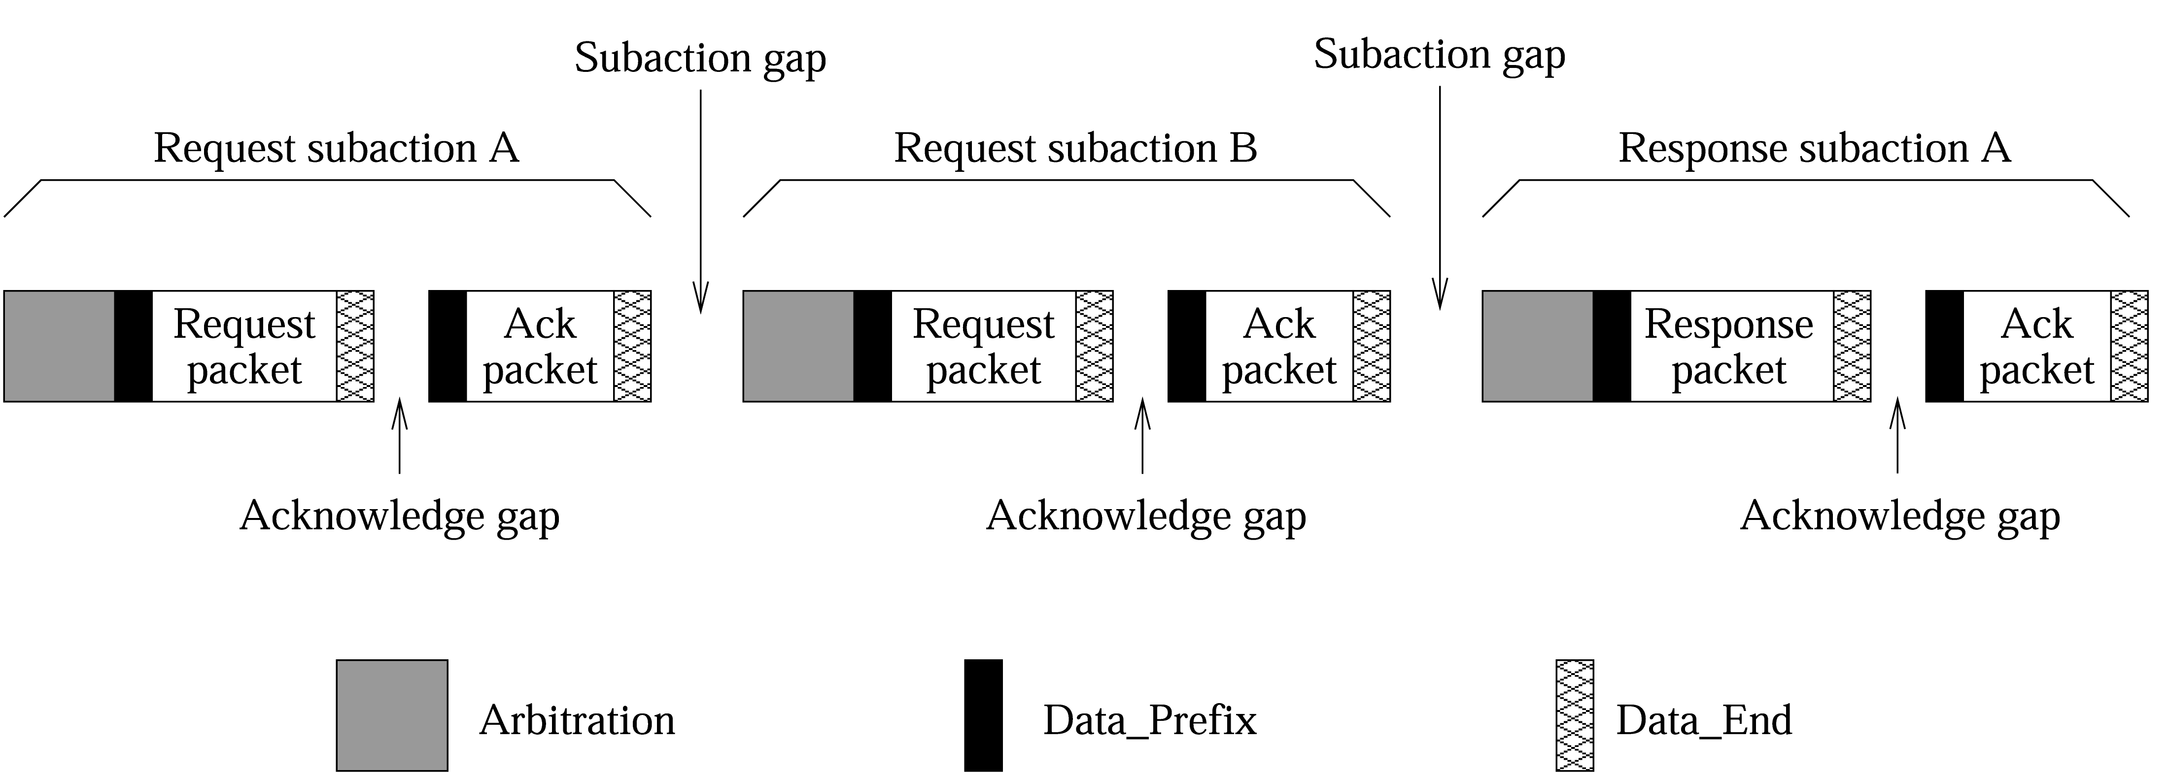
IEEE 1394 (cont’d)
Transactions
  Follow request and reply format
  Each packet is encapsulated between Data_Prefix and Data_end
Chapter 19: Page <number>

Slide 85
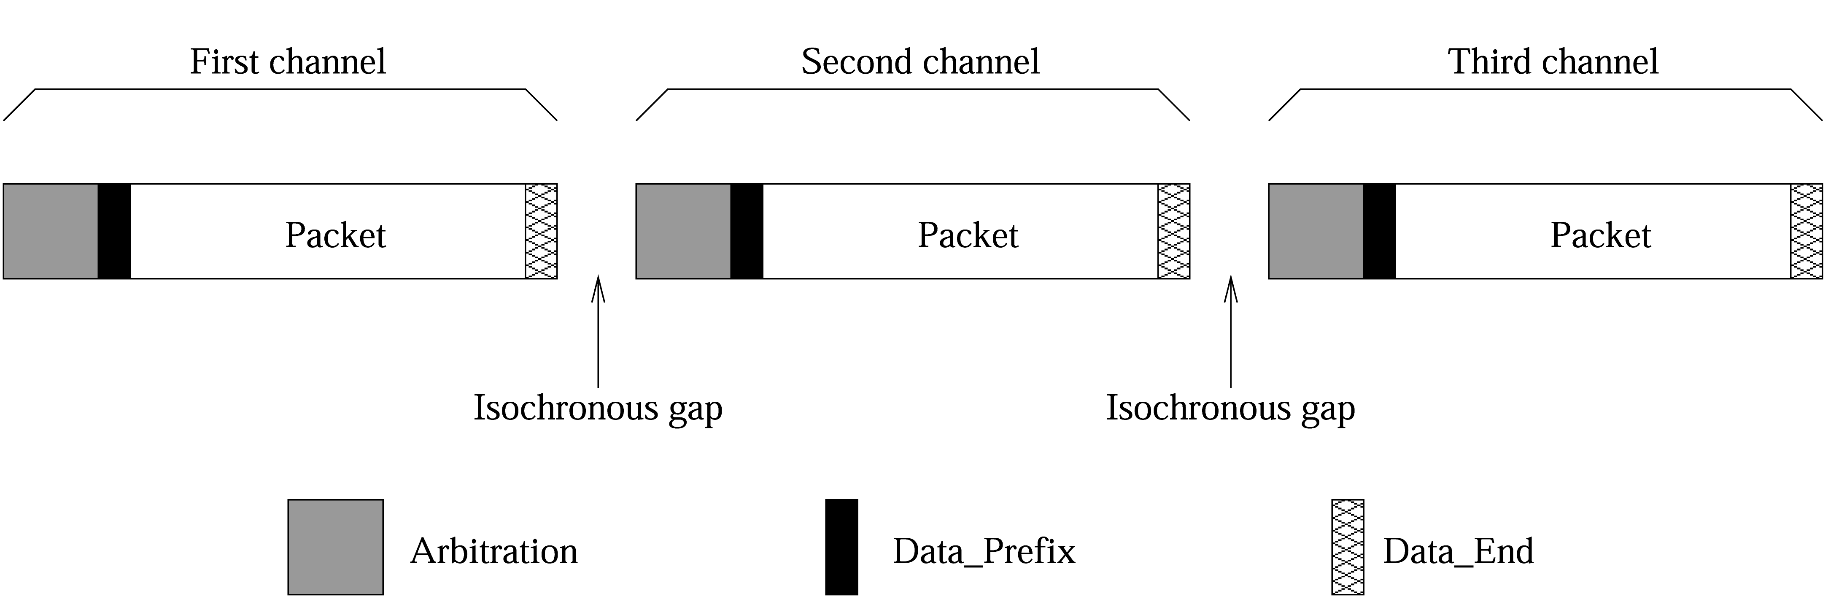
IEEE 1394 (cont’d)
Isochronous transactions
  Similar to asynchronous transactions
  Main difference:
    No acknowledgement packets
Chapter 19: Page <number>

Slide 86
IEEE 1394 (cont’d)
Bus arbitration
  Needed because of peer-to-peer communication
  Arbitration must respect
    Bandwidth allocation to isochronous channels
    Fairness-based allocation for asynchronous channels
  Uses fairness interval
    During each interval
      All nodes with pending asynchronous transaction are allowed bus ownership once
  Nodes with pending isochronous transactions go through arbitration during each cycle
  IRM is used for isochronous bandwidth allocations
Chapter 19: Page <number>

Slide 87
IEEE 1394 (cont’d)
Configuration
  Does not require the host system
  Consists of two main phases
    Tree identification
      Used to find the network topology
      Uses two special signals
        Parent_notify and Child_Notify
    Self-identification
      Done after the tree identification
      Assigns unique ids to nodes
Chapter 19: Page <number>

Slide 88
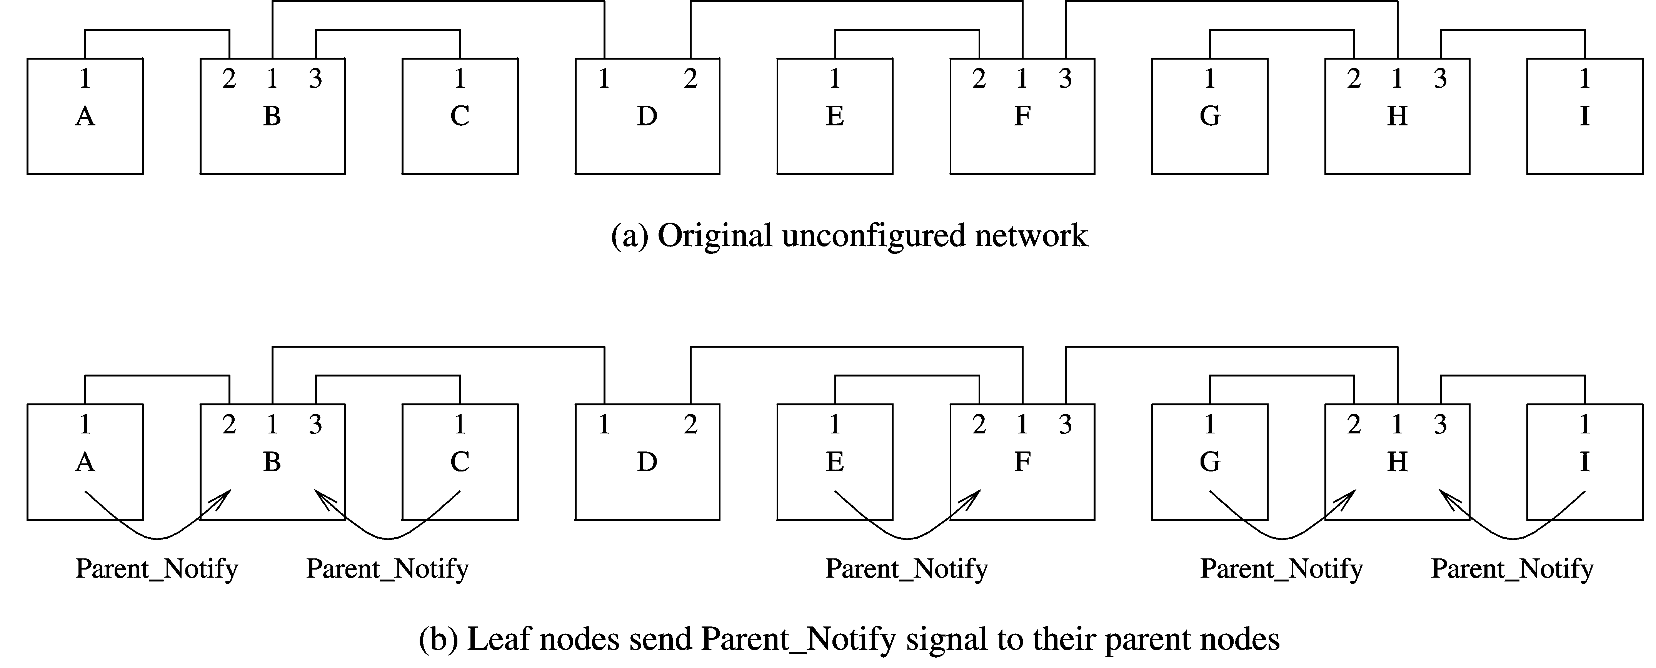
IEEE 1394 (cont’d)
Tree identification
Chapter 19: Page <number>

Slide 89
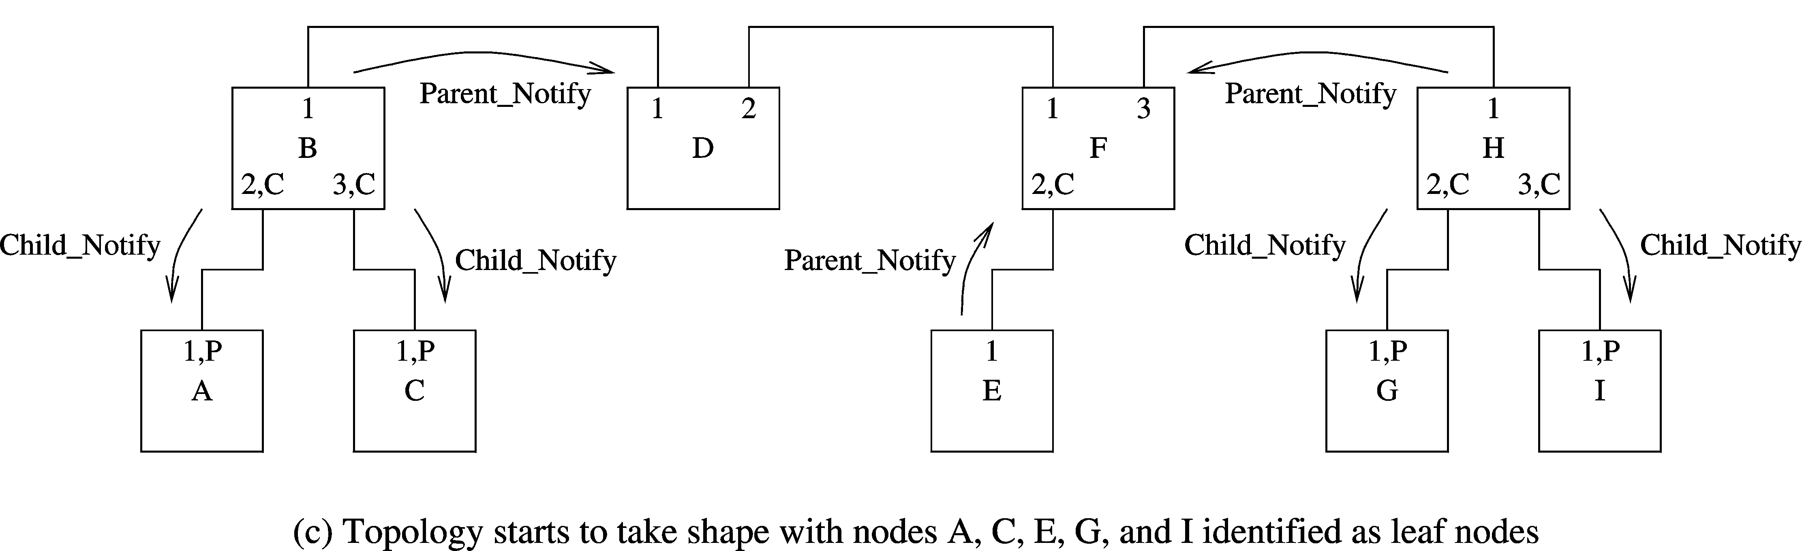
IEEE 1394 (cont’d)
Tree identification
Chapter 19: Page <number>

Slide 90
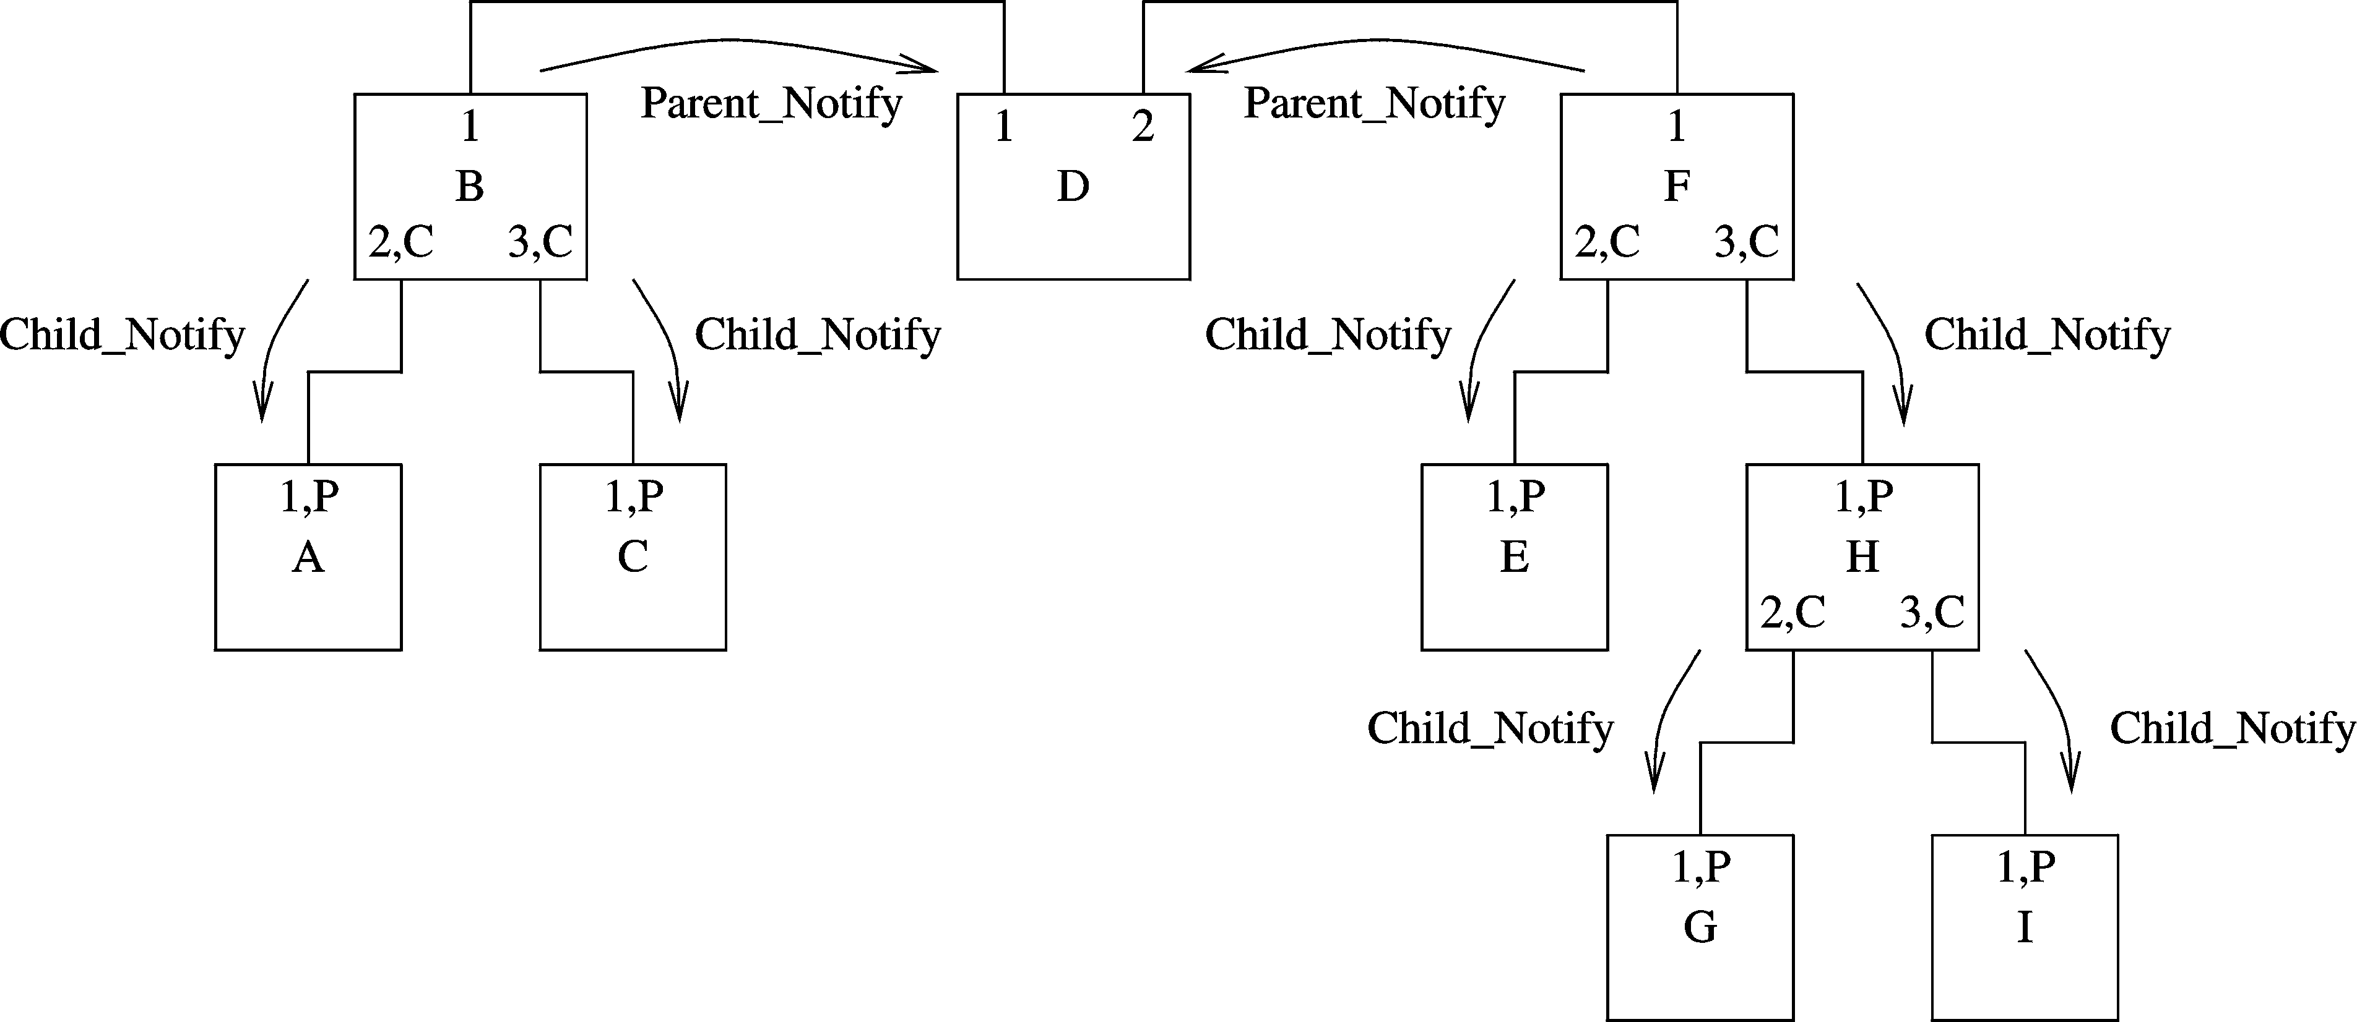
IEEE 1394 (cont’d)
Tree identification
All leaf nodes have been identified
Chapter 19: Page <number>

Slide 91
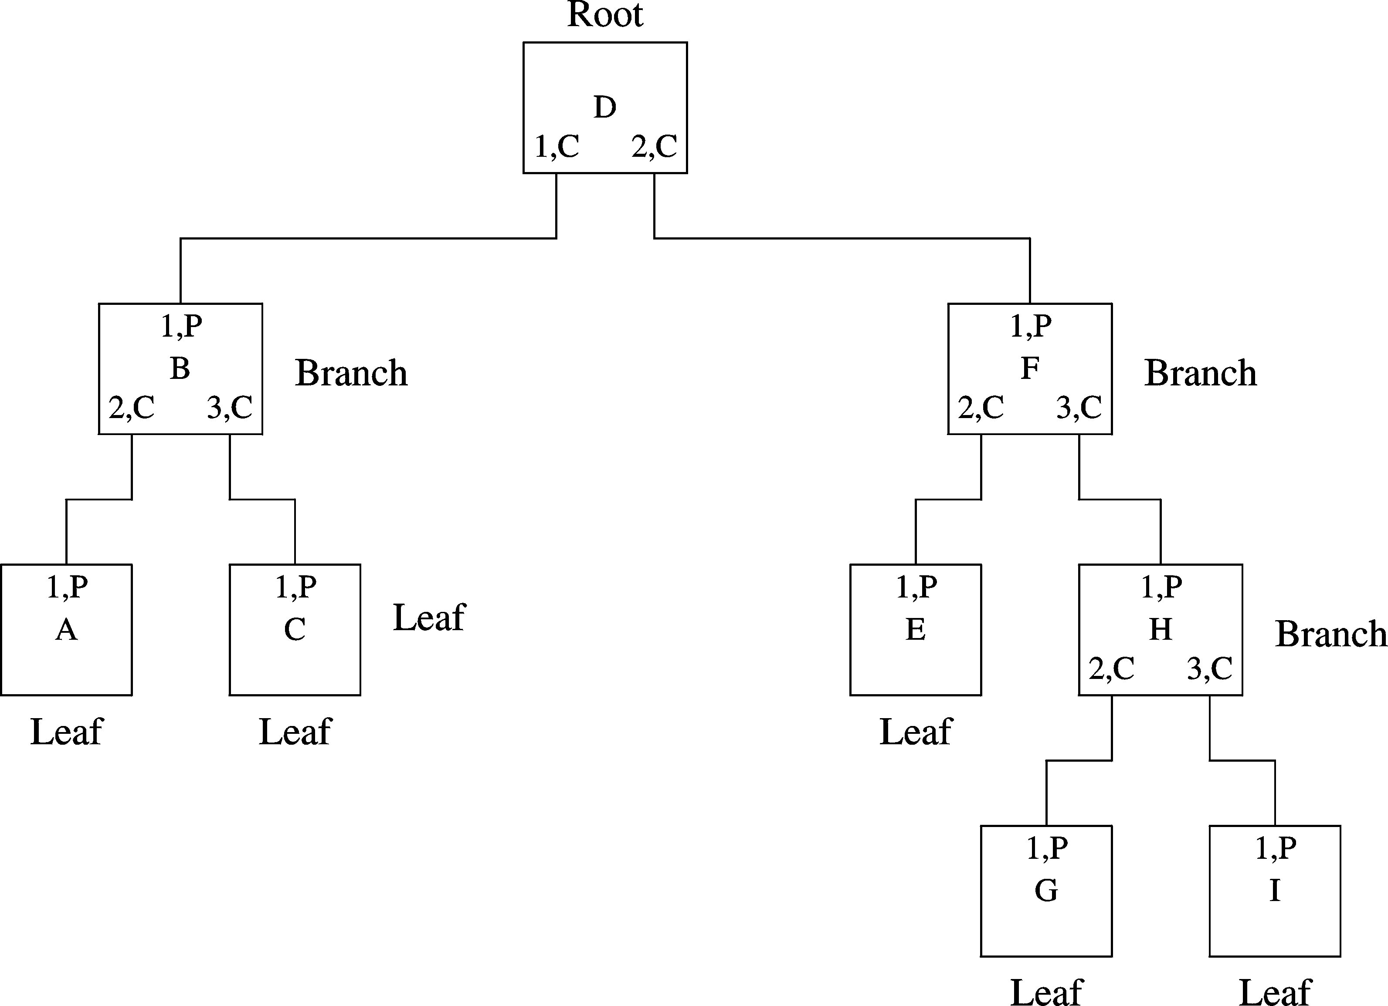
IEEE 1394 (cont’d)
Tree identification
Final topology after tree identification process
Chapter 19: Page <number>

Slide 92
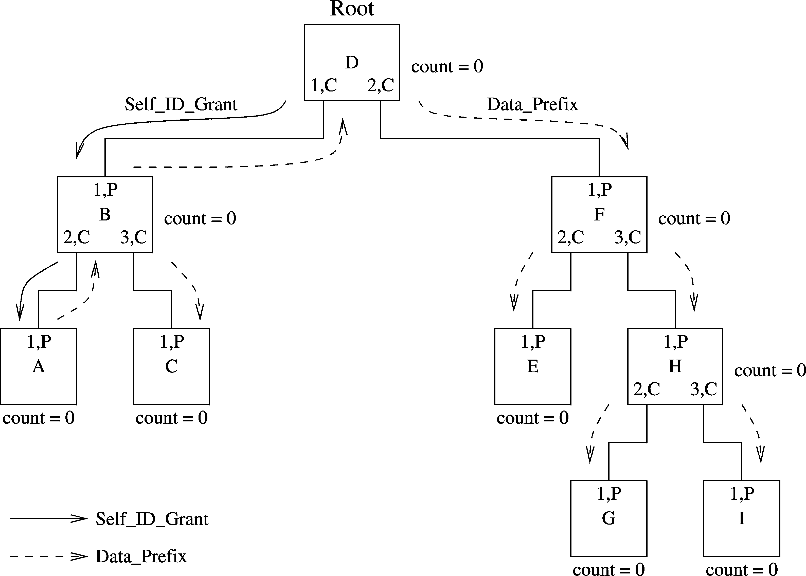
IEEE 1394 (cont’d)
Self-identification
Initial network with count values set to 0
Chapter 19: Page <number>

Slide 93
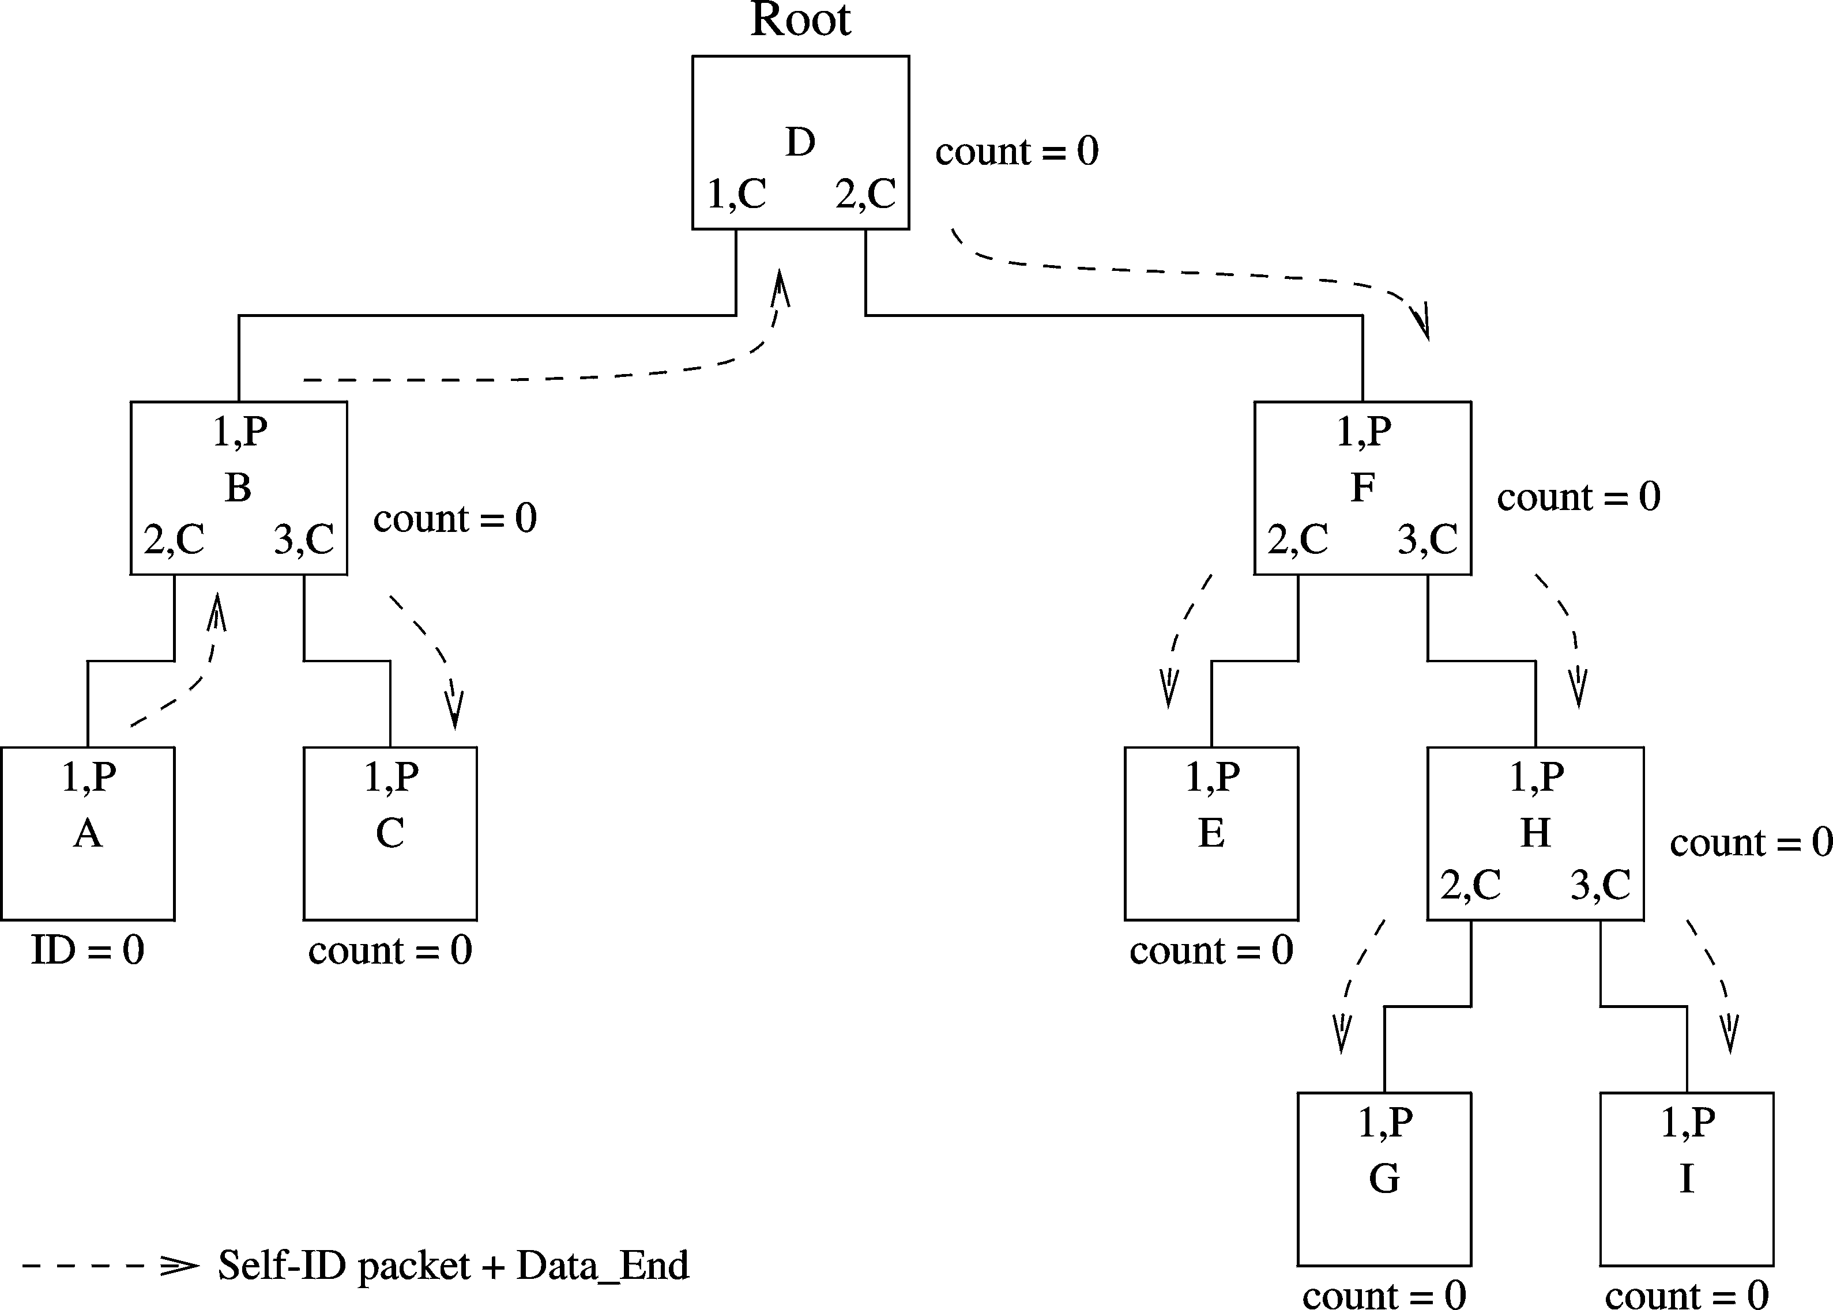
IEEE 1394 (cont’d)
Self-identification
Node A received grant message
Assigns itself ID zero
Chapter 19: Page <number>

Slide 94
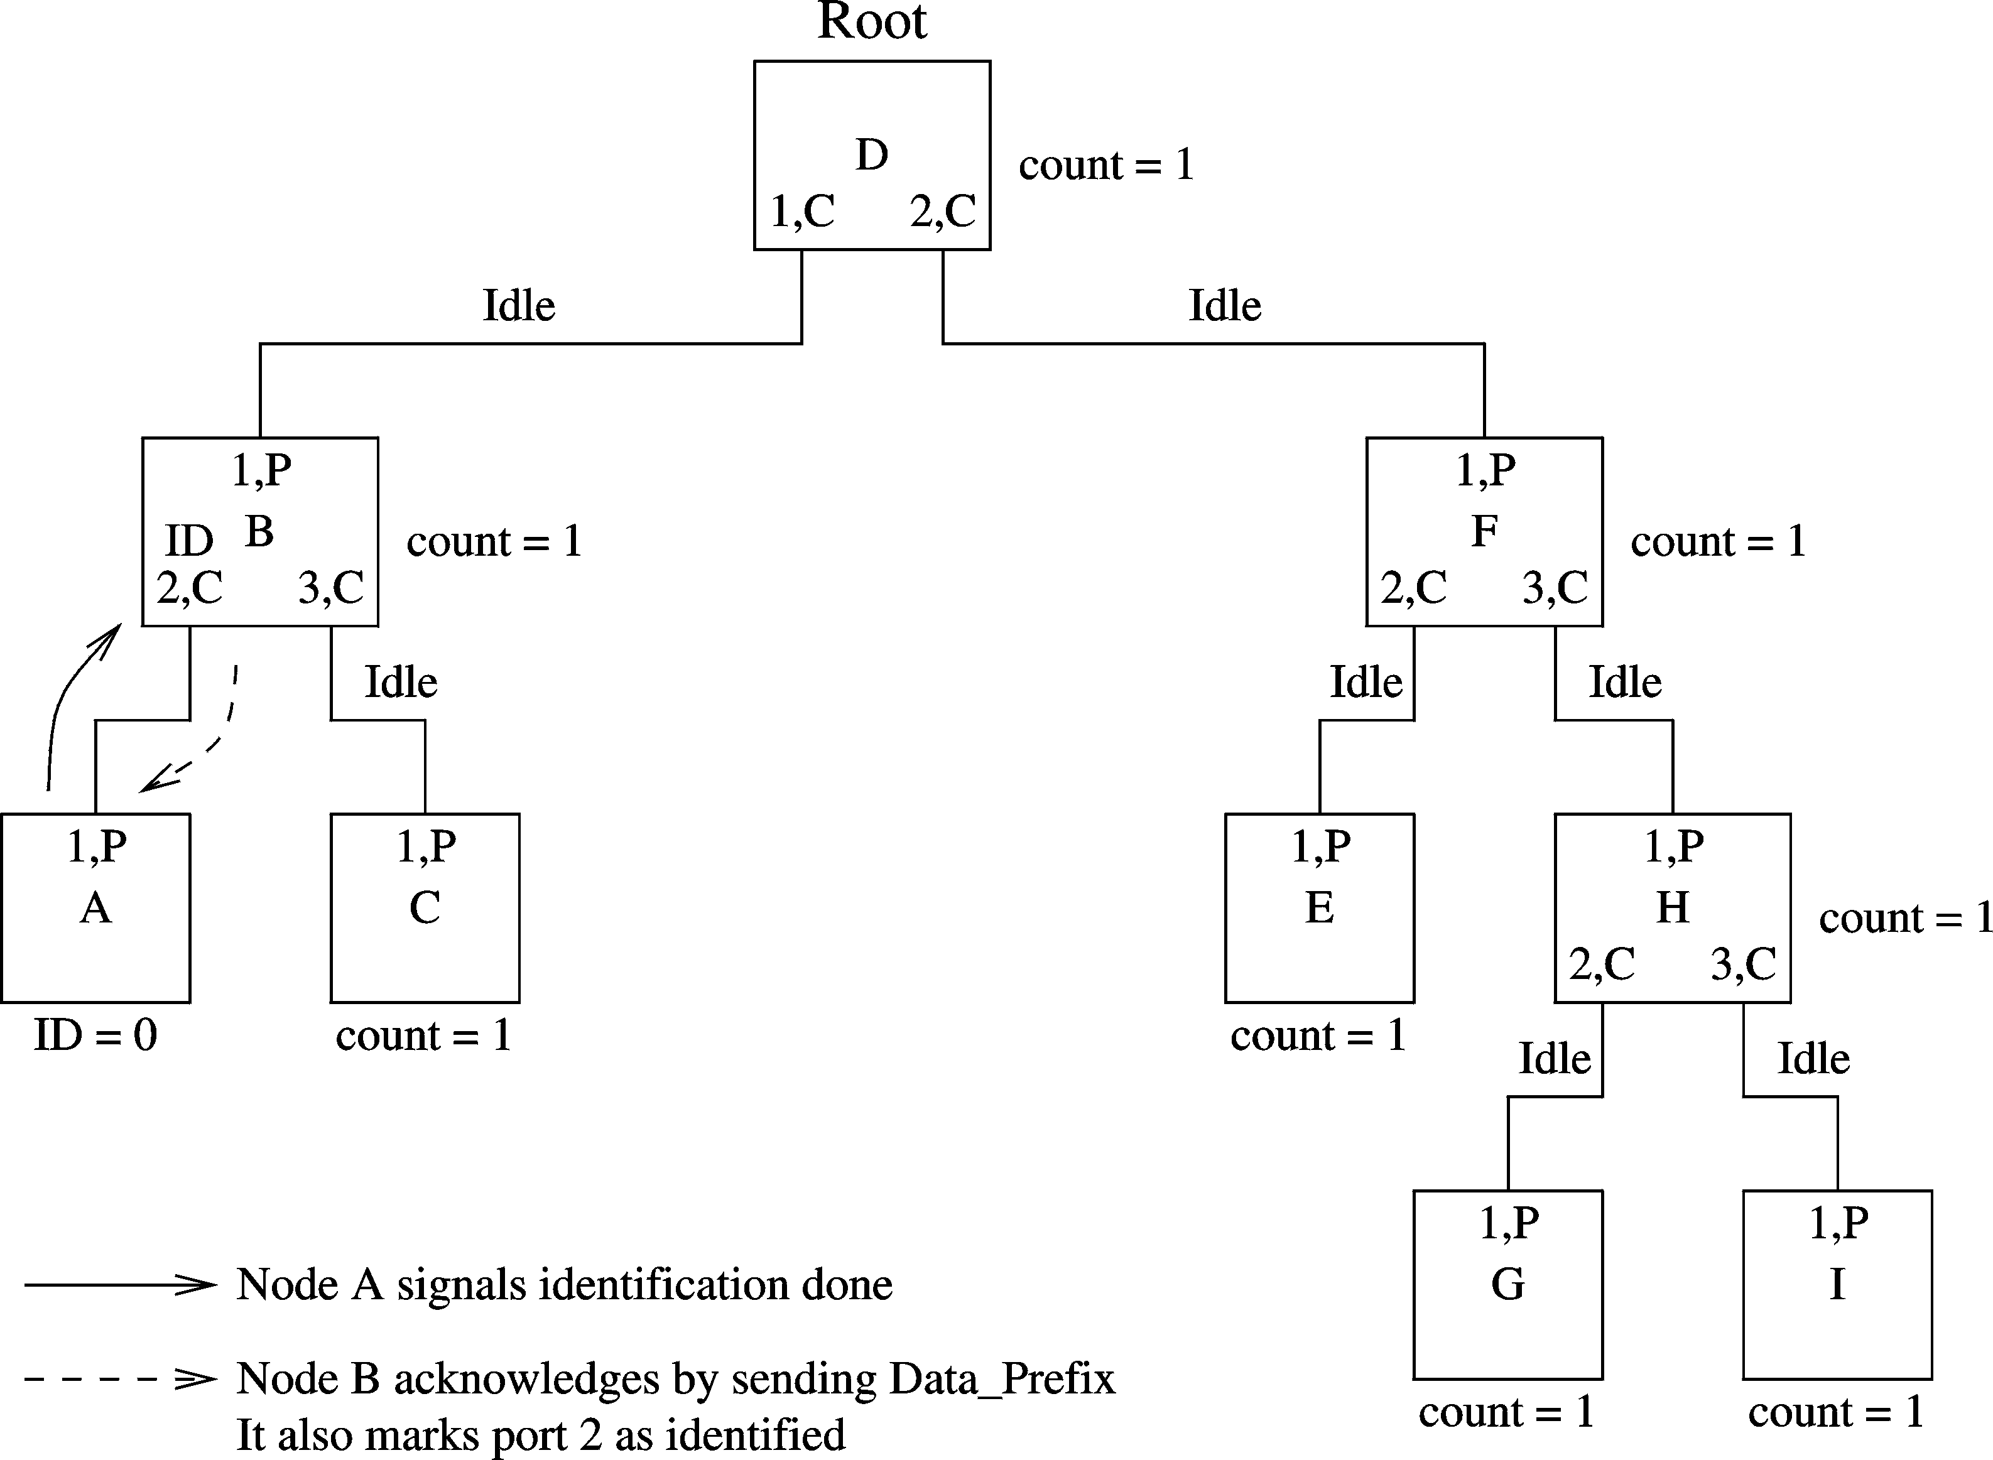
IEEE 1394 (cont’d)
Self-identification
Chapter 19: Page <number>

Slide 95
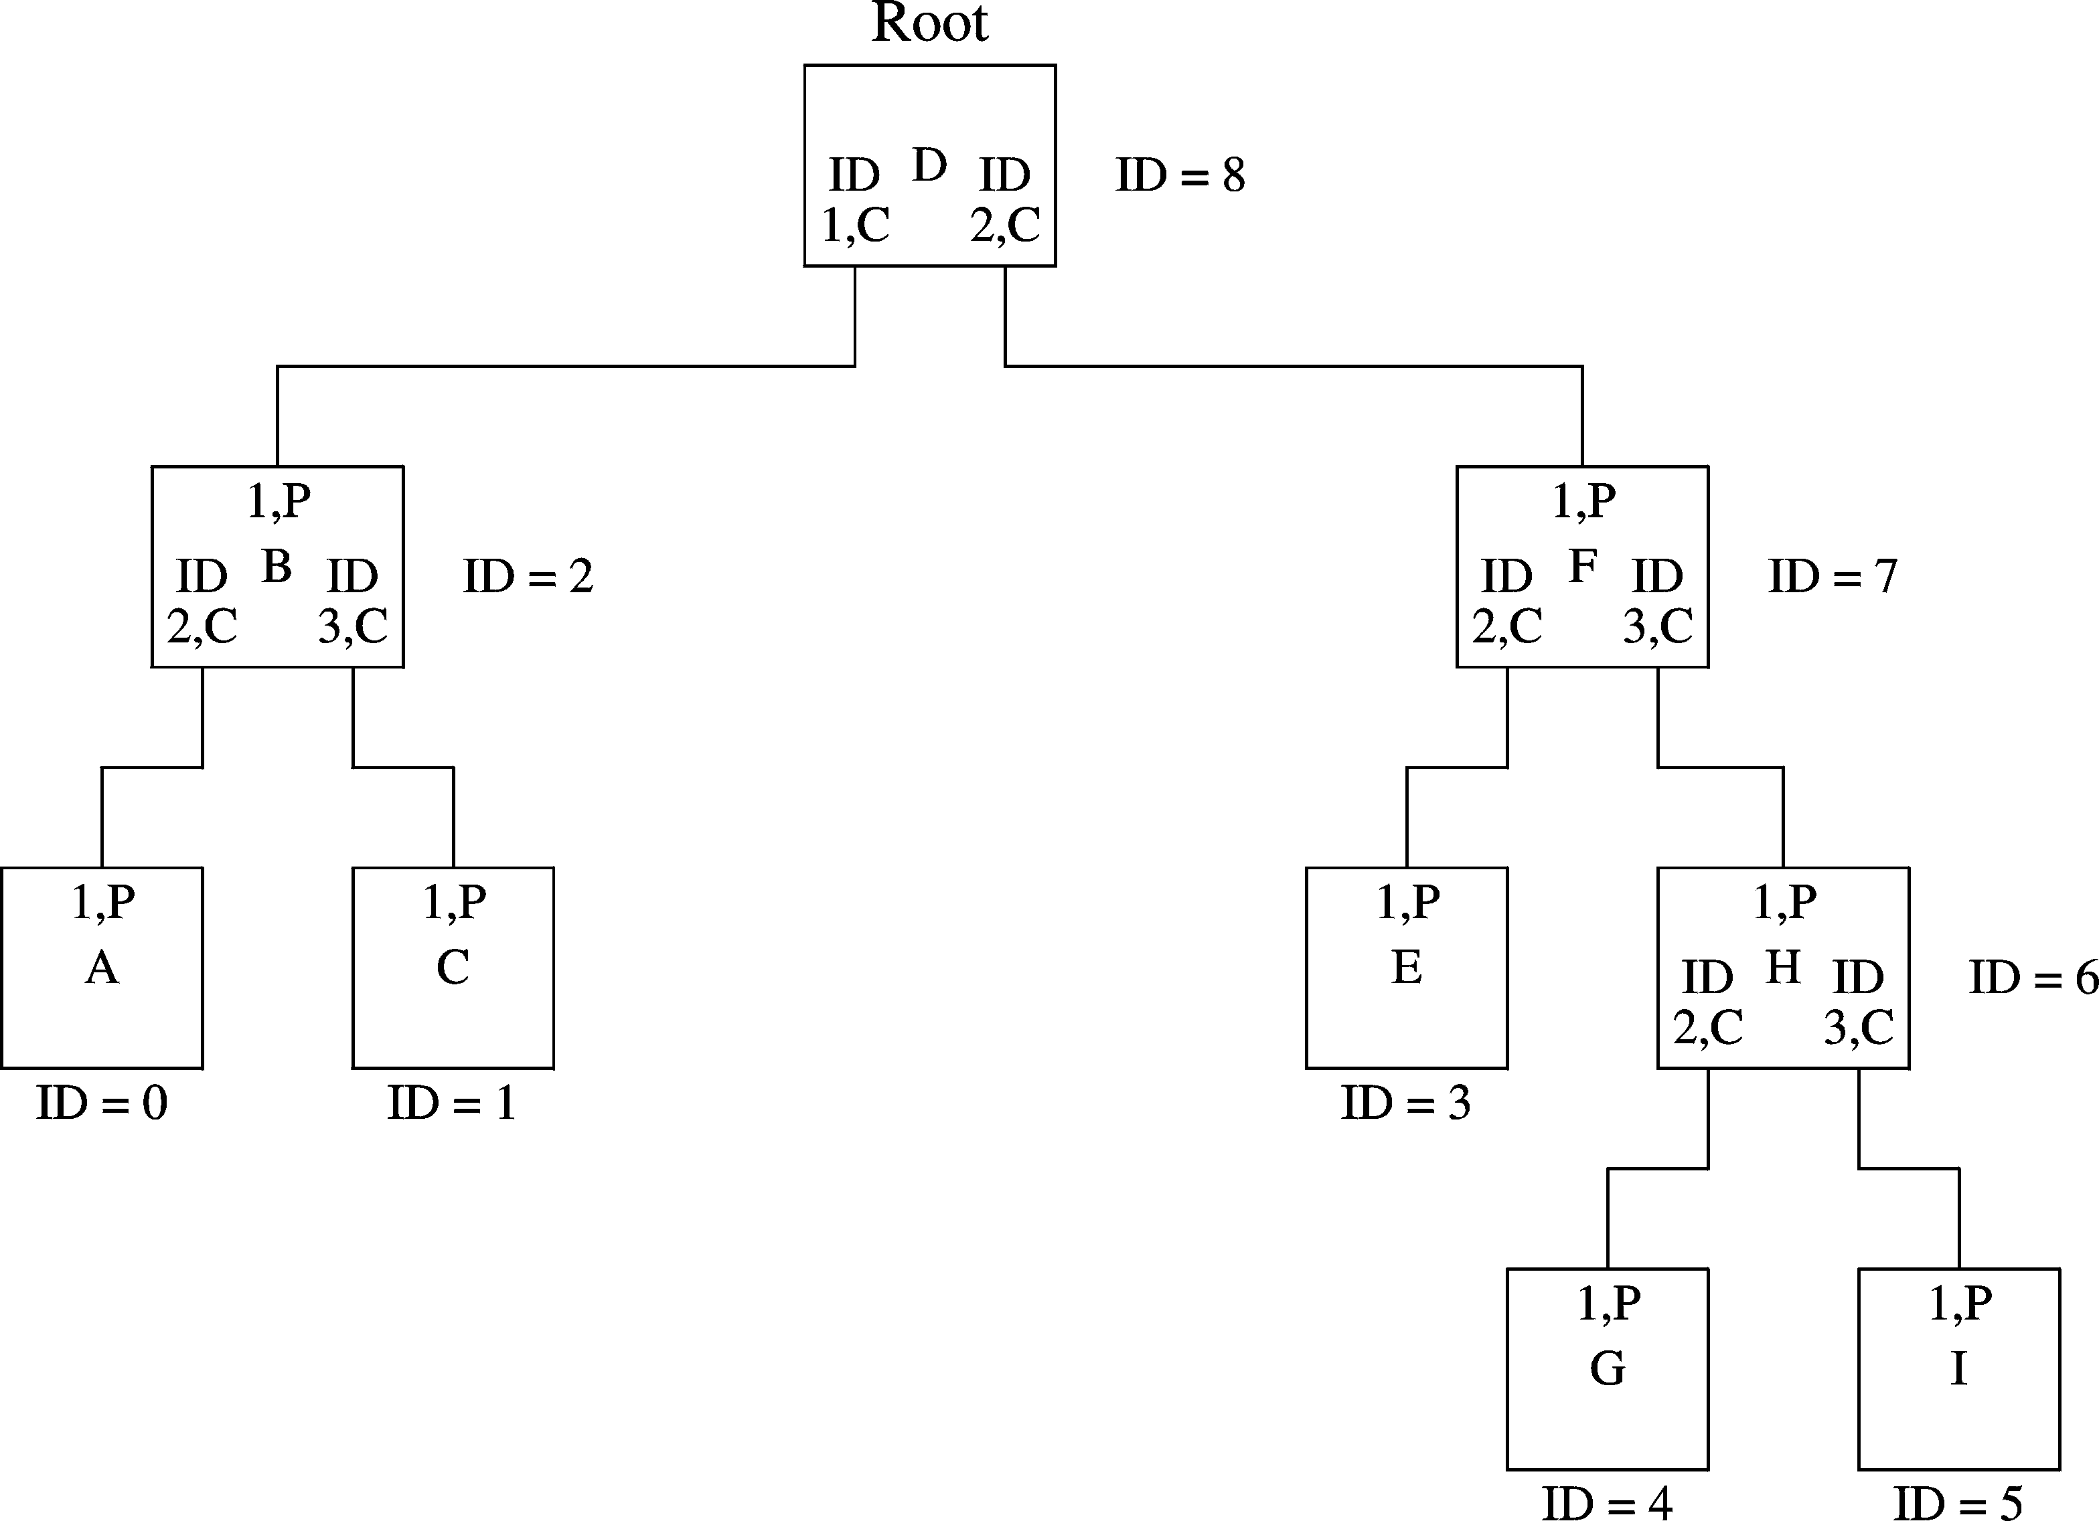
IEEE 1394 (cont’d)
Self-identification
Final assignment of node ids
Chapter 19: Page <number>

Slide 96
Bus Wars
SCSI is dominant in disk and storage device interfaces
  Parallel interface
  Its bandwidth could go up to 640 MB/s
IEEE 1394
  Serial interface
  Supports peer-to-peer applications
  Dominant in video applications
USB
  Useful in low-cost, host-to-peripheral applications
  USB 2.0 provides high-speed support
Last slide
Chapter 19: Page <number>

